Slide 1


Application of AI in Development of AI Chatbot and Training Evaluation and Development
Artificial Intelligence: Challenges in Public Service Training
DISPA 2024 – Network of Directors of Institutes and Schools of Public Administration
25th October 2024

Slide 2
1
Portugal's Digital Public Administration Transformation: Public Policies
2
Portugal's Digital Public Administration Transformation: Practical Examples
3
AI in Public Sector Training: INA’s Strategic Role
Agenda
4
INA’s Internal AI Projects in Progress
5
Application of AI in Training Evaluation
6
Challenges and Future Opportunities

Slide 3
Portugal's Digital Public Administration Transformation: Public Policies

Slide 4

Public Policies
1. National Digital Strategy
The Council for Digital in Public Administration (CDAP) was established by the RCM no. 94/2024, July 25.
The CDAP's Strategic Committee will coordinate the National Digital Strategy and its action plan.
Current strategies such as Digital Transformation for Public Administration, 5G, Cloud in Public Administration, Open Data will be renewed and aligned under the National Digital Strategy.
The proposal along with the action plan should be publicly presented by the end of November.

Slide 5

Public Policies
2. National Smart Territories Strategy
Established by the RCM no. 176/2023, December 18. Will be aligned with the National Digital Strategy and includes the launch of the Smart Territories Portal, which aims to transform data into knowledge for efficient and sustainable territorial management.
3. Recovery and Resilience Plan

Slide 6
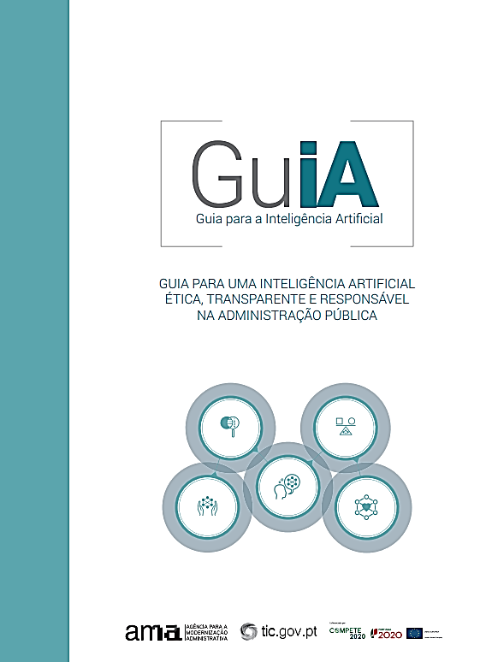
Responsible AI Guide for Public Administration
Presents principles, guidelines, and a model for developing ethical and responsible AI projects in public administration.
Includes:
  Definition
  Benefits
  Strategy
  Risks and Implications
  Risk Mitigation
  AI Dimensions
  Practical Guides
  Evaluation Tool

Slide 7
Portugal's Digital Public Administration Transformation: Practical Examples

Slide 8



GovTech Justice
Accelerate innovation by bringing the Government and the innovation and entrepreneurship ecosystems and by sharing best practices in adopting emerging technologies and GovTech projects. Portugal is the first country to integrate GPT-4 technology within its justice system.
Example: Chatbot GPJ - Practical Guide to Justice; Automatic Company name generator; Automated anonymization of court decisions.
IRN and ChatGPT Integration
Chatbot that uses a generative artificial intelligence language model based on GPT-4 technology.
Example: Chatbot IReNe, to respond in any language to questions about residence permit renewal. In the future, new AI tools will be tested in other areas, for example: respond to emails and support phone service.
AI in Public Procurement
Court of Auditors (with the OECD and supported by the European Commission), leverages AI to modernize public procurement, ensuring greater transparency and efficiency in handling large-scale data.
Example: AI-driven models process vast amounts of public contract data, enabling real-time insights and improving decision-making in public procurement.

Slide 9



Legislative Impact with AI
Use of AI algorithms to support the legislative impact assessment exercise in the EU.
Supported by Nova IMS.
Example: AI4AI@EU - Artificial Intelligence for Better Regulation in the EU. Assists in the legislative impact assessment process, by providing automated reports on community directives and other legislation.
AI in Healthcare Solutions
The Shared Services of the Ministry of Health is participating in the European initiative TEF-Health (Testing and Experimentation Facility for Health AI and Robotics). Aiming to develop testing and experimentation facilities for artificial intelligence (AI) and robotics in healthcare.
Example: AI and robotics solutions - enhance the efficiency, resilience, and sustainability of healthcare systems.
Id.gov and AI-based Avatar
Leads administrative modernization in Portugal, focusing on Digital Transformation, Omnichannel Public Service, and Administrative Simplification.
Example: Two flagship solutions: Id.gov and a realistic Avatar based on Generative Artificial Intelligence.

Slide 10
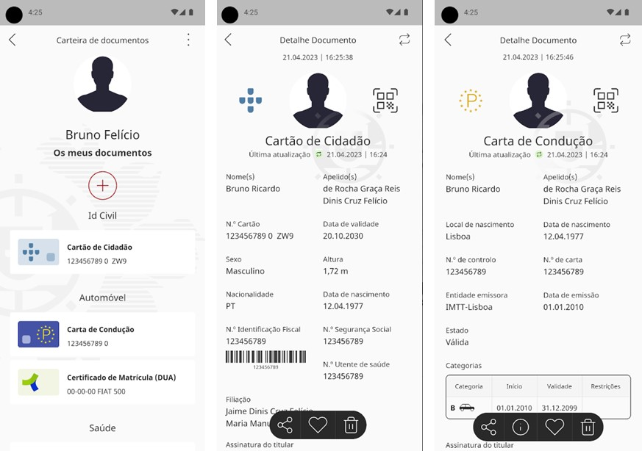
id.gov.pt
A Public Administration application that enables the storage and consultation of cards (e.g., citizen card, driver's license, ADSE card) anytime and anywhere, utilizing the Digital Mobile Key.
Portugal's National Digital Strategy emphasizes interoperability and reducing bureaucratic burdens through data reuse.

Slide 11
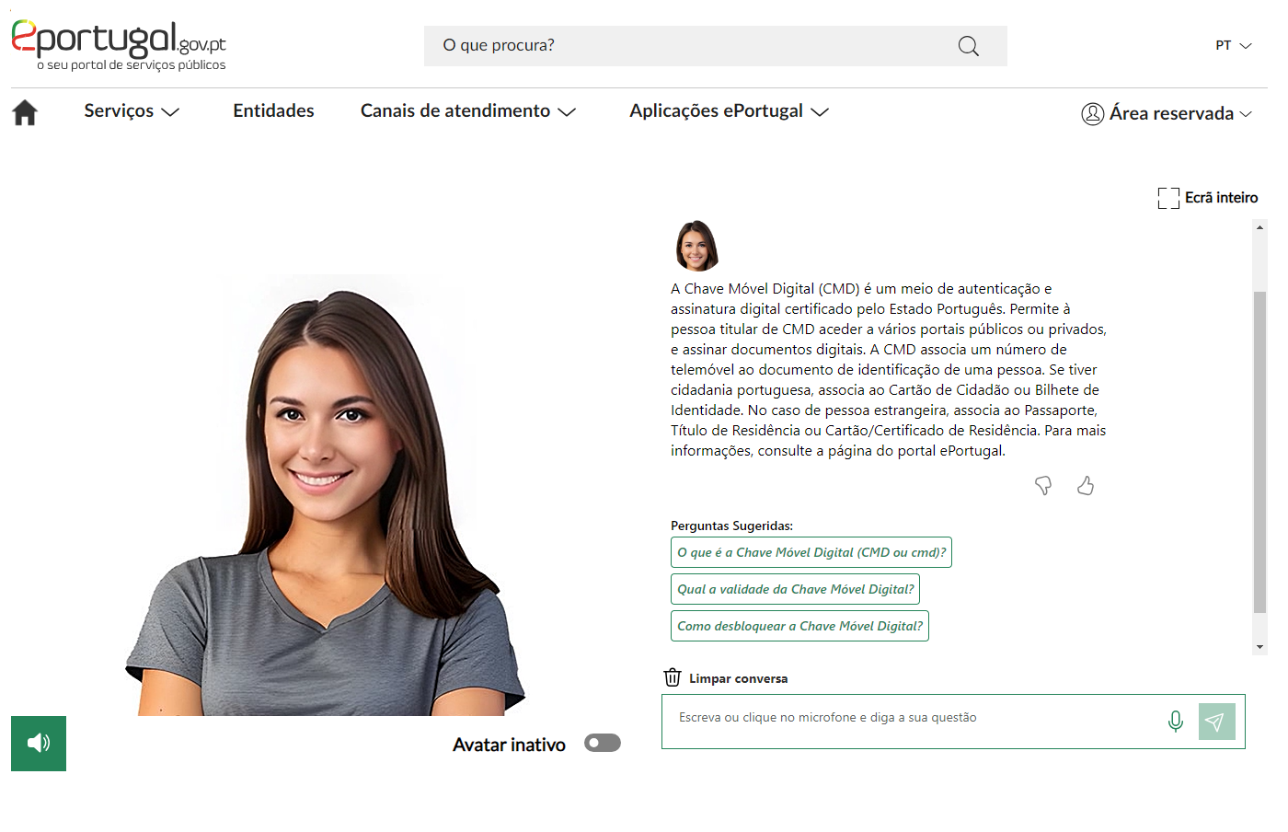
ePortugal Chatbot
An AI-powered chatbot, based on the CHATGPT 3.5 turbo, with a realistic avatar, assists citizens in finding necessary information.
It understands both written and spoken Portuguese, providing responses either in text or through voice synthesis.
The chatbot also understands Spanish and English, offering written responses after translating the relevant information stored in its databases.
This innovative solution is a result of a partnership between AMA, Microsoft, DareData Engineering, and Defined.ai.
  Since its launch, e-ID activations have increased by 10%.

Slide 12
AI in Public Sector Training: INA’s Strategic Role

Slide 13

INA’s mission
Empower civil servants through advanced training programs that leverage cutting-edge technology, including AI.
Prepare the public sector workforce for a future where AI is a core component of operational efficiency and service delivery.
INA promotes innovation and modernization in public administration through education, research, and advisory services.

Slide 14
AI-related courses in the 2024 training program
Program | Training Type | Course Name | Duration | Institution
Digital Comp. in Emerging Technologies | Online Asynchronous | Artificial Intelligence | 9h | -
 | Online Synchronous | Introduction to Artificial Intelligence | 14h | -
Consortium IP>AP | Online Synchronous | Artificial Intelligence for Managers, Project Managers, and IT Teams | 14h | FEP, AMA
 | Online Synchronous | Artificial Intelligence in Society and Public Services | 21h | FCUL
 | Online Synchronous | Artificial Intelligence Course from the User's Perspective | 40h | ISCTE
 | Online Synchronous | Applied Artificial Vision | 24h | IPCA
 | Online Synchronous | Machine Learning (Knime) | 21h | FEP
 | Online Synchronous | Literacy in Technology-Supported Translation with Artificial Intelligence | 21h | NOVA FCSH
 | Online Synchronous | Design of Public Services Supported by Generative Artificial Intelligence | 21h | NOVA IMS
 | Online Synchronous | Ethical and Legal Challenges of Artificial Intelligence | 14 | NOVA School of Law
 | Online Synchronous | AI Business School for Public Administration | 60h | 6 Universities

Slide 15

Benchmark Program for Public Administration
  The AI Business School AP is a pioneering program designed to equip the Portuguese Public Administration with essential AI skills.
  Partnership with Microsoft, INSEAD and six prestigious educational institutions
    Together with INA, these institutions have launched the first AI course for the Portuguese Public Administration.
  Target Audience - Public Sector Leaders
    Senior and middle managers in Public Administration; also open to senior technicians and IT specialists.
  Equip leaders with skills to develop AI strategies to create institutional value and optimize public service.

Slide 16






Learning Path
Program Curriculum
The training is provided online during work hours via the INA’s Moodle platform, with Portuguese instruction and English support materials.
Duration: 60 hours
Maximum of 40 participants per edition.
Curricular Units | Institutions | Duration
1. Define an AI strategy to create institutional value |  | 10h
2. Learn how to accelerate an Al-ready culture in your organization |  | 10h
3. Identify the guiding principles for responsible AI |  | 10h
4. Al for organizational users |  | 10h
5. Scale Al & Open Al in your organization |  | 10h
6. Introduction to AI technology for organizational leaders |  | 10h

Slide 17
Perfomance Metrics
400% Attractiveness Rate
  4 participants for each available position
  For this year, all available positions are filled
Editions Overview
  4 editions delivered
  1 planned for November 2024 (40 participants)
  4 planned for 2025 (2 are already filled)
AI Business School Summit with all the participants from all Editions to foster innovation and collaboration withing Public Administration by January 2025.
157 Public Leaders trained to date.

Slide 18
INA’s Internal AI Projects in Progress

Slide 19
AI Technology
INA’s Internal AI Projects
Chat DTP
ReCAP AI
A platform using AI for quick and easy access to training document information through natural language queries.
1
3
AI-powered virtual assistants to create and scale training content based on the Competency Framework for Public Administration.
Formando 360
2
4
Chatbot INAcreditável
A data analytics initiative to consolidate and analyze training data from multiple platforms.
A chatbot developed to answer frequently asked questions from trainees, trainers, and organizations about INA's services.

Slide 20




Chat DTP
Expected Benefits
The Problem
The Solution
STATUS
Difficulty in retrieving information in the training documents (Technical-Pedagogical Dossier), which are stored in a complex folder system. This makes it hard to quickly retrieve the necessary information.
CHAT DTP provides a natural language interface for quick answers about Technical-Pedagogical Dossiers for each course. This computational platform will utilize a generative AI library (Open.AI https://platform.openai.com/) and the corporate environment of Microsoft SharePoint and Active Directory.
Efficiency: Faster access to information, reducing search time.
Accessibility: Simple, natural language queries for all users.
Streamlined: Integration ensures up-to-date, easily accessible data.
Project is almost complete and in the testing phase.

Slide 21
Chat DTP Workflow: From Question to Instant Information
STEP 01
STEP 02
STEP 03
STEP 04
Ask a Question (Natural Language Query)
AI Processes the Query
Retrieve Information from Training Documents
Receive Accurate, Quick Answers

Slide 22
Formando 360
Expected Benefits
The Problem
The Solution
STATUS
Lack of consolidated data from various sources to effectively manage and support training, making it difficult to assess results and plan for organizational performance.
The FORMANDO 360 project uses Microsoft Fabric and AI to gather and consolidate data from multiple platforms, enabling better analysis and evaluation of training outcomes.
Improved Decision-Making: Access to consolidated data allows for more informed decisions in training management.
Enhanced Planning: Supports the planning and evaluation of organizational performance through analytics.
Streamlined Processes: Easier data management from multiple sources in one platform.
In development.

Slide 23
Formando 360 Workflow: From Data Collection to Decision Making
STEP 01
STEP 02
STEP 03
STEP 04
Provide Training Data (Performance, Feedback)
AI Analyzes the Data
Receive Insights on Training Effectiveness
Adjust Training Plans

Slide 24
ReCAP AI
Expected Benefits
The Problem
The Solution
STATUS
Difficulty in efficiently developing training content for behavioral skills defined in the Competency Framework for Public Administration (ReCAP), approved by Ordinance No. 214/2024/1, dated September 20, across core transversal competencies: Public Service Orientation, Collaboration Orientation, Change and Innovation Orientation, and Results Orientation.
The ReCAP AI project uses AI-powered virtual assistants (via Chat GPT) to create, train, and test assistants capable of generating pedagogical matrices, content drafts, scripts, and templates for training units. These assistants will be scalable to cover all competencies in ReCAP.
Efficient Content Creation: Faster production of training materials tailored to the ReCAP competencies
Scalability: The AI-based solution can be extended to additional competencies.
Team Empowerment: Training the INA team to adapt and further develop AI assistants for other projects.
AI Literacy: Increases understanding of AI opportunities and risks among the INA team.
In development.

Slide 25
ReCAP AI Workflow: From Data Input to Content Creation
STEP 01
STEP 02
STEP 03
STEP 04
Input Training Needs (Competency Requirements)
AI Generates Training Materials
Receive Tailored Content
Validate with Experts

Slide 26
Chatbot INAcreditável
Expected Benefits
The Problem
The Solution
STATUS
Difficulty in efficiently responding to frequent queries from trainees, trainers, and organizations regarding INA's services. This resulted in increased manual workload and delays in providing consistent, accurate information about training management, institutional framework, and support services. Additionally, the information on the INA website is outdated, causing confusion.
INAcreditável, an AI-powered chatbot, was developed to provide automated answers to frequently asked questions from trainees, trainers, and public administration organizations. It covers topics such as training management, institutional details, training requests, coordination, and enrollment.
Increased Efficiency: Automated responses reduce manual workload and provide instant answers.
Consistency: Ensures standardized responses across all queries, reducing human error.
User-Centric: Tailored responses for three distinct user profiles (Public Administration Entities, Trainers, and Trainees).
Accessibility: 24/7 availability of information regarding training, enrollment, and certificates.
In development / under testing.

Slide 27
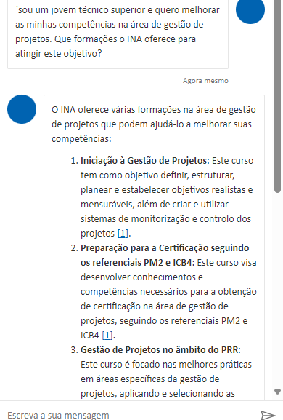
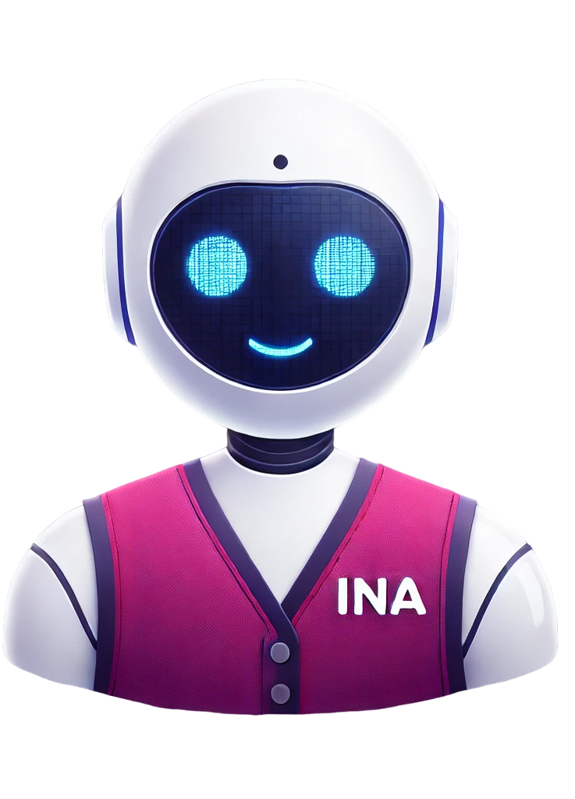
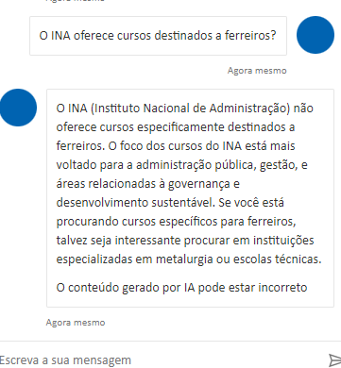
The chatbot is tailored to respond to three user profiles: Public Administration Entities, Trainers, and Trainees, ensuring up-to-date and consistent information.

Slide 28
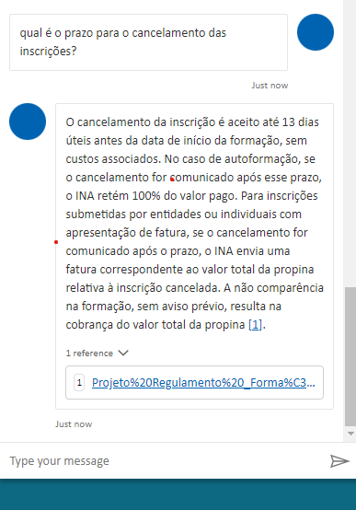
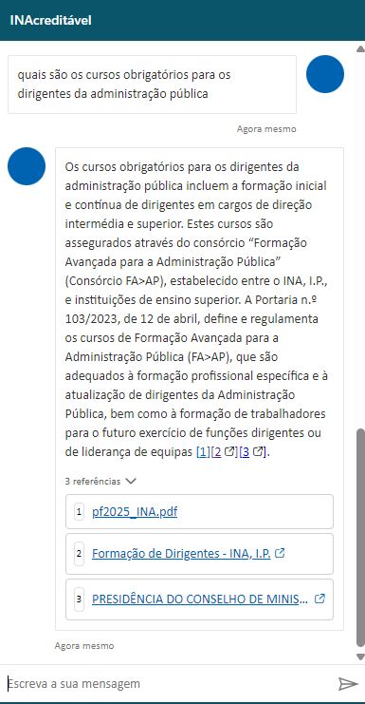
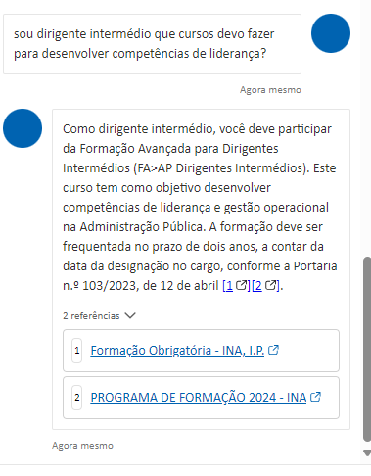
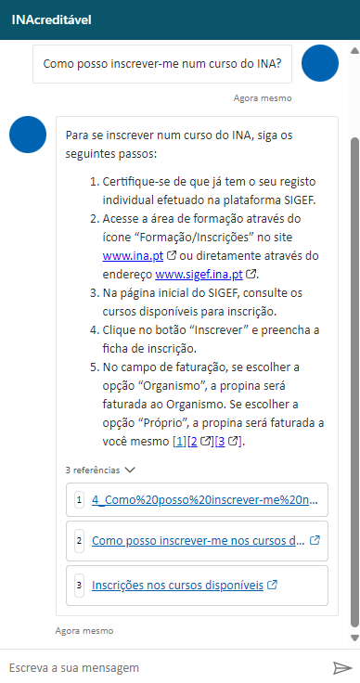
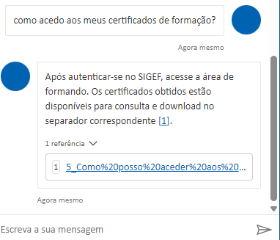

Slide 29
Chatbot INAcreditável Workflow: From FAQ Input to Automated Responses
STEP 01
STEP 02
STEP 03
STEP 04
Ask a Question (About INA’s Services)
Receive Tailored Response Based on Profile
Access Information on Training, Enrollment, Certificates
Immediate Assistance Available 24/7

Slide 30
Application of AI in Training Evaluation

Slide 31
Concept and Exploration for Future Implementation
Why AI in Training Evaluation?
Current Challenges
Manual evaluation processes are time-consuming
Lack of personalized feedback for trainees
Difficulty in tracking long-term competency development
Opportunities
AI can transform training evaluation by automating tasks
Provide real-time feedback
Scaling across large participant groups.
  AI offers the potential to enhance efficiency, improve personalization, and allow for data-driven decision-making.

Slide 32
Key Features of AI-Driven Training Evaluation
Data Collection & Integration
AI-Powered Performance Analytics
Personalized Feedback for Trainees
AI automates data collection from training programs, performance metrics, feedback forms, and assessments.
AI identifies patterns, predicts future performance, and highlights areas for improvement.
AI delivers real-time, personalized feedback and suggests further training paths for each trainee.
Automated Surveys
Outcome and Impact Measurement
Dashboard and Reporting
AI analyzes feedback forms using natural language processing to understand participant engagement and satisfaction.
AI tracks competency improvements and links training results to real-world job performance.
Provides real-time insights into trainee progress and training effectiveness via dynamic dashboards and reports.

Slide 33



Next Steps – Preparing for AI Implementation
Research Phase
Pilot Program
Data Collection
Begin exploring AI solutions that are tailored to training evaluation.
Research existing technologies that could be adapted to our needs.
Design a small-scale pilot to test AI-driven evaluation systems.
The pilot will allow us to evaluate the effectiveness of AI in real-world scenarios and gather feedback for improvements.
Ensure that we have high-quality, structured training data for the AI system to analyze.
Proper data preparation is essential for accurate predictions and insights.

Slide 34
Challenges and Future Opportunities

Slide 35







Key Challenges
Opportunities
Rapid technological advancements (AI, blockchain, IoT) requiring constant infrastructure and skill updates.
Continuous professional training needed to keep pace with evolving technologies.
Ensuring digital inclusion, especially for vulnerable groups such as the elderly and disabled, in access to public services.
Developing interoperable, secure systems that prioritize data privacy.
Leveraging emerging technologies to streamline public services and enhance citizen engagement.
Collaboration between government, educational institutions, and the private sector to offer cutting-edge digital skills training.
Advancing AI and data analytics to create efficient, citizen-centered services.

Slide 36

Digital transformation goes beyond technology – it’s about equipping civil servants with the skills to serve citizens more efficiently in the digital age.
Civil servants are at the heart of digital transformation.
AI’s rapid progress is inevitable, making it essential to address ethical and social challenges.
The State and Public Administration must ensure AI benefits society and enhances public services.

Slide 37
Q
A
&
Questions & Answers
abel.carreira@ina.pt
Thank you!

