Slide 1
Performances and Applications of AI in Public Administration in Greece
Athanasios Raptis, EKDDA
Director of National School for Public Administration and Local Government
Budapest, Oct 25 ,2024

Slide 2
Aim and Contents
Aim
Contents
The presentation is about how from available public sector data, we can, through machine learning and AI, create value for the citizens. As demonstration, a model will be used with data from the training of civil servants. Furthermore, will be presented examples of AI applications from the Greek Public Administration
Reasoning Mechanism for AI
The role of Data to reasoning Mechanism
Public Sector Data for AI training
AI Usecases from the Greek Public Sector

Slide 3
Data and AI

Slide 4
Reasoning Mechanism of AI
Reasoning mechanisms are the core processes that enable artificial intelligence systems to think, learn, and make decisions. They are the computational models that mimic human cognitive abilities
Deductive reasoning: Drawing conclusions based on given logical rules .
Inductive reasoning: Generalizing rules from specific observations to broader patterns.

Slide 5
Types of Reasoning Mechanisms
Rule-based systems: These systems use a set of predefined rules to make decisions. expert systems, where domain-specific knowledge
Statistical learning: This approach involves training models on large datasets to identify patterns and relationships.
Probabilistic/Fuzzy reasoning: This technique uses probability theory to represent uncertainty and make decisions based on the likelihood of different outcomes.
Symbolic reasoning: This approach involves manipulating symbols and logical expressions to represent knowledge and reason about it.
Neural networks: These models are inspired by the structure and function of the human brain. They consist of interconnected nodes (neurons) that process information in parallel. Neural networks are particularly effective at learning complex patterns from data.
Notes:
Rule-based systems: These systems use a set of predefined rules to make decisions. They are often used in expert systems, where domain-specific knowledge is encoded in rules.
Statistical learning: This approach involves training models on large datasets to identify patterns and relationships. It is commonly used in machine learning algorithms like neural networks and support vector machines.
Probabilistic reasoning: This technique uses probability theory to represent uncertainty and make decisions based on the likelihood of different outcomes. Bayesian networks and Markov decision processes are examples of probabilistic reasoning models.
Symbolic reasoning: This approach involves manipulating symbols and logical expressions to represent knowledge and reason about it. It is used in knowledge-based systems and theorem provers.
Neural networks: These models are inspired by the structure and function of the human brain. They consist of interconnected nodes (neurons) that process information in parallel. Neural networks are particularly effective at learning complex patterns from data.

Slide 6
The role of Data to Intelligence
Data is the raw material of intelligence.
It's the information that AI systems use to learn, reason, and make decisions.
The path from data to intelligence typically involves several key steps:
1. Data Collection and Preparation
2. Data Analysis and Exploration
3. Model Selection and Training
4. Model Evaluation
5. Deployment and Maintenance

Slide 7
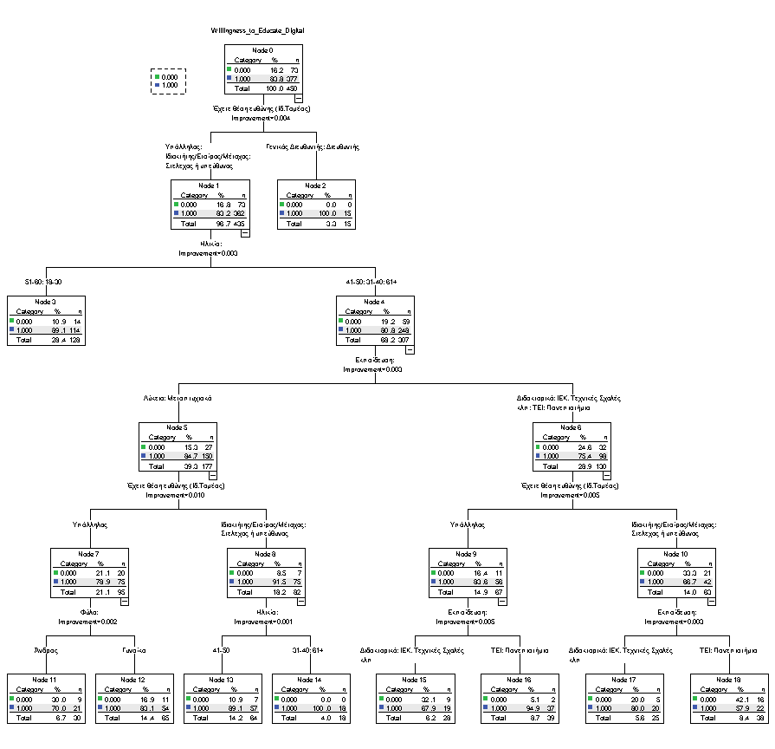
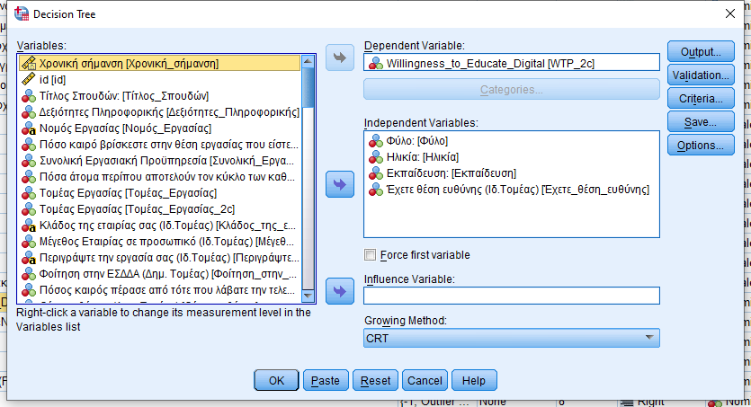
Educational Example
Key role to AI, are playing the Clustering Algorithms.
Here is the example of creating a decision tree for the willingness to educate in digital, using simple data from a questionnaire.

Slide 8
Data utilization in Digital Economy
Private Sector
Public Sector
Monetizing data:
1. Data-as-a-Service (DaaS)
2. Analytics as a Service (AaaS)
3. Data Licensing
4. Data Partnerships
5. API Access for Developers
6. Targeted Advertising
7. Building a Data Marketplace
8. Customized Data Solutions
9. Monetizing User Data through Value Exchange
10. Monetizing Data for Product Development
11. Predictive Models and AI Solutions
Creating value to citizens:
1. Data-Driven Policy Support
2. Infrastructure and Urban Planning Solutions
3. Government Contracts for Data Services
4. Open Data Platforms and Public-Private Partnerships
5. Predictive Analytics for Public Services
6. Data Licensing for Research and Policy Development
7. Smart City and IoT Data Solutions
8. Public Safety and Security
9. Environmental Monitoring
10. Healthcare Data Solutions
11. Transportation and Mobility Data
12. Disaster Response and Management
13. Public Procurement Data
14. Data-Enhanced Citizen Services

Slide 9
Conclusion
1. Data Governance and Management
2. Data Quality and Accessibility
3. Data Privacy and Security
4. Data Sharing and Interoperability
5. Ethical Use of Data
6. Data for Innovation and AI Development
7. Monitoring and Continuous Improvement
Build an ecosystem of Public Sector DATA
Using Digital, we obtain the «Α», using Data we obtain the «Ι» No Data, No AI
Notes:
1. Data Governance and Management:
Clear Ownership: Public sector institutions need to establish clear data ownership rules, ensuring that it’s clear who is responsible for data collection, storage, and protection.
Data Stewardship: Designating data stewards ensures proper handling, sharing, and quality maintenance of data across agencies.
Compliance with Laws and Regulations: Ensure that all data use complies with existing laws such as privacy regulations (e.g., GDPR), security policies, and other governmental standards.
2. Data Quality and Accessibility:
High-Quality Data: Ensure that data collected is accurate, relevant, and timely, with mechanisms for regular updating and cleansing.
Open Data Standards: Public data should be made available in machine-readable formats to foster innovation, with minimal restrictions while ensuring privacy and security.
3. Data Privacy and Security:
Privacy Protections: Ensure the data policy protects individuals' privacy and aligns with data protection laws. The use of personal data must be transparent, with informed consent where applicable.
Secure Data Management: Implement strong cybersecurity measures to protect data from breaches, unauthorized access, and misuse.
4. Data Sharing and Interoperability:
Cross-Sector Collaboration: Establish frameworks for safe and secure sharing of data between public institutions, academia, and private organizations.
Interoperability: Ensure that different systems can exchange, interpret, and use data effectively through standard protocols and formats.
5. Ethical Use of Data:
Bias Mitigation: Policies should promote unbiased data collection and usage practices to prevent discrimination in AI outcomes.
Transparency and Accountability: Public sector AI systems should have transparency mechanisms, with policies in place to ensure accountability for AI decisions and actions.
6. Data for Innovation and AI Development:
Data Availability for AI: Public institutions should make non-sensitive datasets open for AI research, innovation, and development, encouraging experimentation and model training.
Public-Private Partnerships: Promote partnerships with private AI developers to leverage both public data and private expertise, while safeguarding public interests.
7. Monitoring and Continuous Improvement:
Performance Evaluation: Implement monitoring mechanisms to assess AI models’ performance, ensuring continuous improvement in line with ethical standards.
Feedback Mechanisms: Set up systems that allow for public and institutional feedback on AI use and data handling to address concerns and improve practices.

Slide 10
Applications of AI to Greek Public Sector

Slide 11
Leveling -Dimensioning of AI in Greece
Development of AI in Greece is performed in various levels and dimensions:
Political Level
Strategic Level
Legislative
Technological
Citizen oriented
Internal systems of Administration
Educational
Dozens of AI Apps, regulations, performances, etc, in Public Sector

Slide 12
Strategy - Legislative framework - Alignment with EU Regulations and Frameworks
In 2022, the Hellenic Parliament passed a law (nο 4961/2022) regulating the development and use of AI in both the public and private sectors.
The law focuses on the obligations of public sector bodies and their contractors who develop and use AI systems, ensuring the protection of citizens from potential risks associated with the operation and use of such systems.
High Level Advisory Committee for AI, consists from worldwide experts
The National Digital Strategy 2020-2025 provides the foundation for Greece’s digital transformation and outlines key areas for AI development in the public and private sectors.
Several more national regulations, guidelines etc

Slide 13
Technological
New high performance computer – HPC «DEDALOS».
Computational Power of 60 petaFlops
60 trillion floating point operations per second
40 million euros, 1500 sq meters

Slide 14
Technological
Quantum Computing Infrastructure for Greece

Slide 15
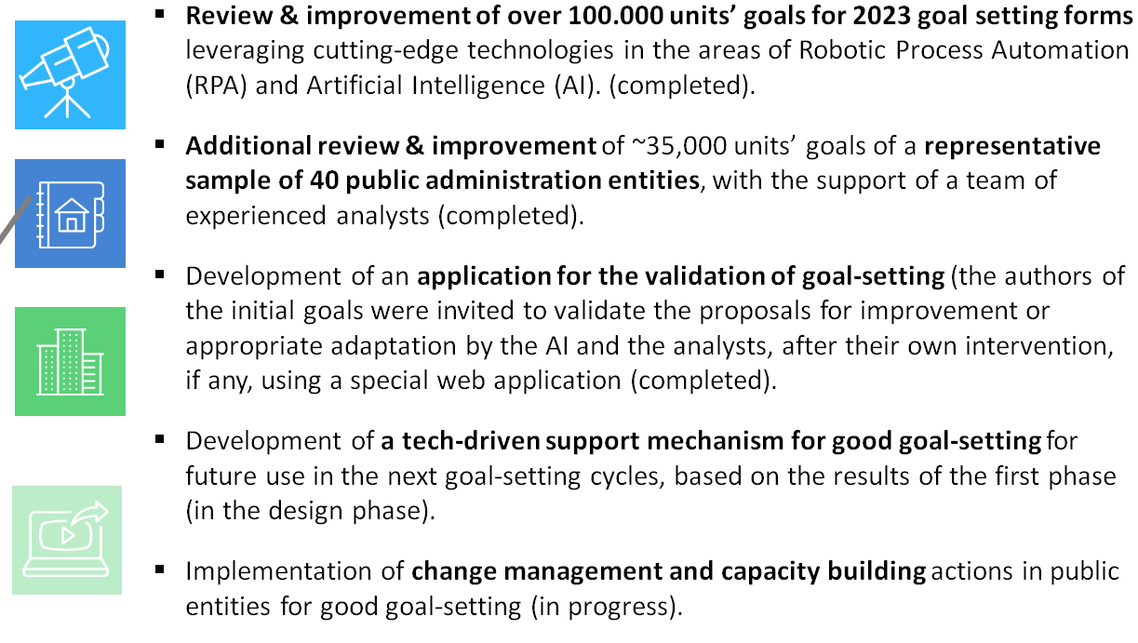
AI for Internal Public Administration Purposes: Goal setting 1/3

Slide 16
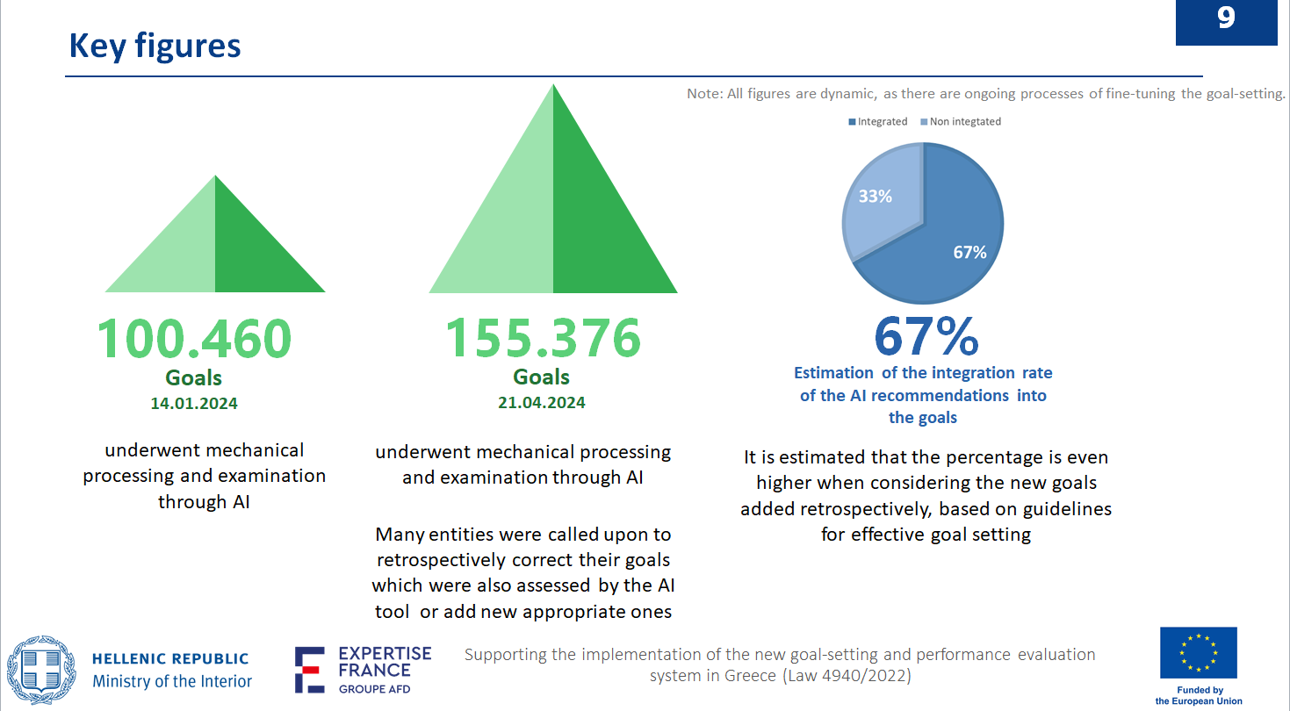
AI for Internal Public Administration Purposes: Goal setting 2/3

Slide 17
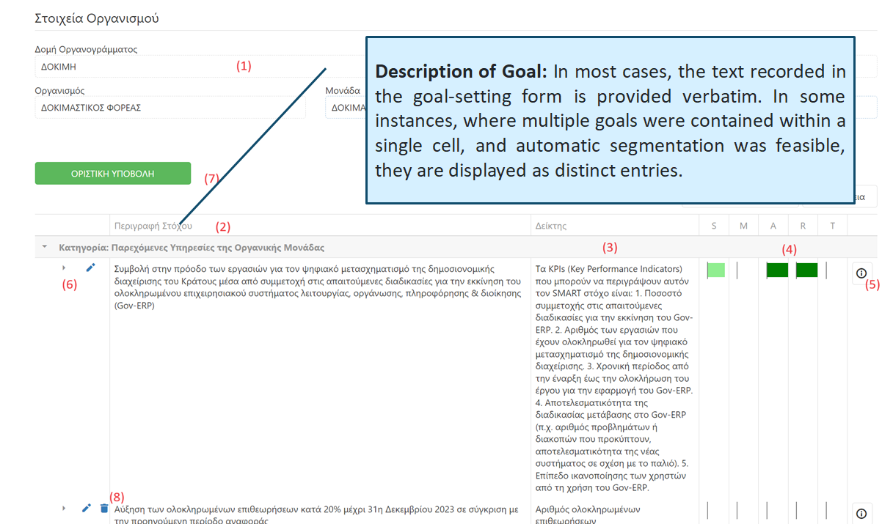
AI for Internal Public Administration Purposes: Goal setting 3/3

Slide 18
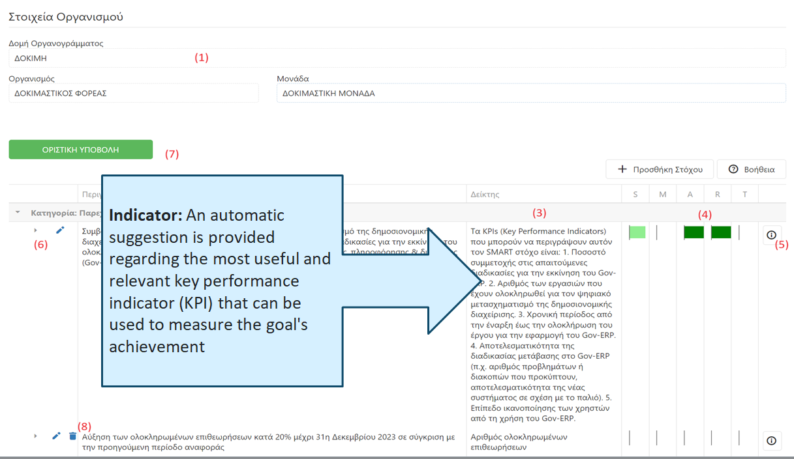
AI for Internal Public Administration Purposes: Goal setting 4/5

Slide 19
AI for Internal Public Administration Purposes: Goal setting 5/5

Slide 20
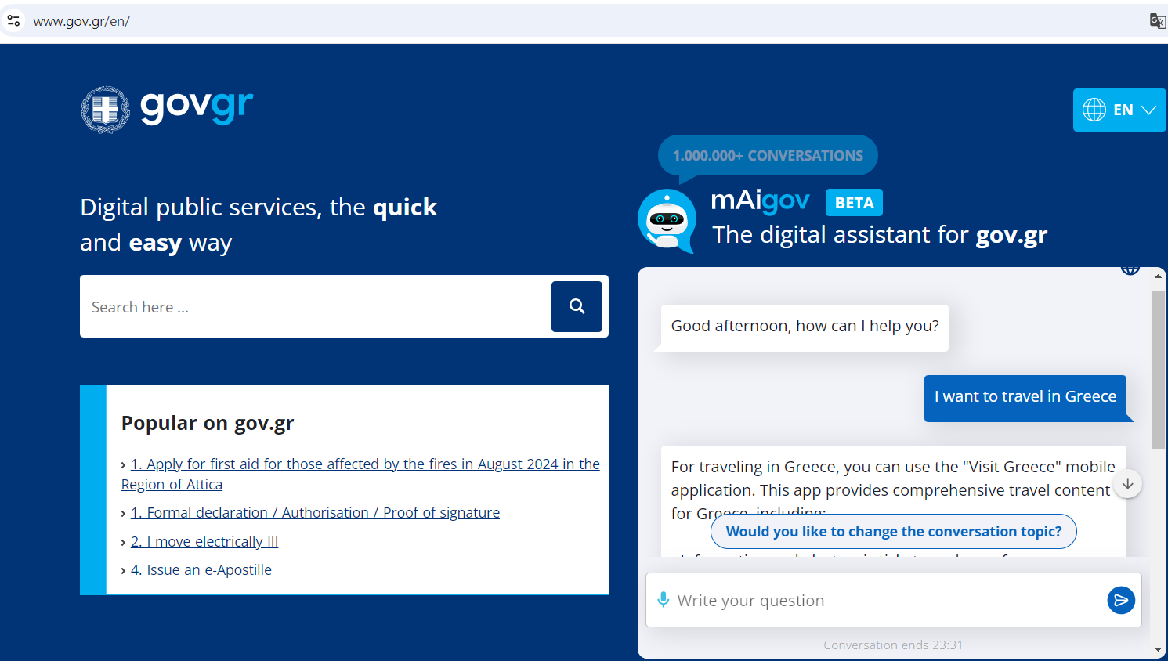
Citizen oriented Apps: mAIgov

Slide 21
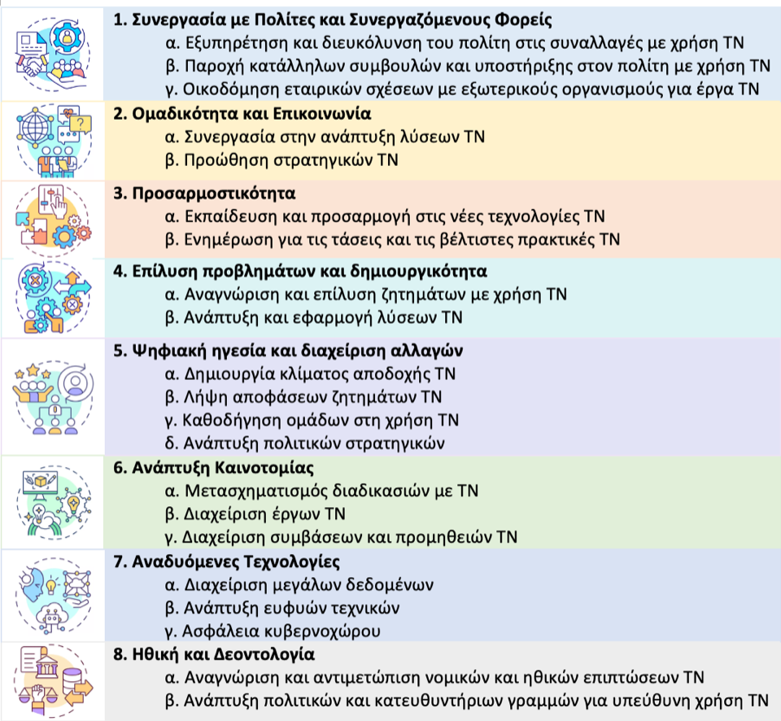
Educational
Collaboration with Google to offer AI education to thousands of public administration employees (INEP/EKDDA)
AI for all ESDDA students & Creativity with AI lab (ESDDA/EKDDA)
Building a national Competency framework for AI

Slide 22
Key Barriers
Lack of AI Infrastructure and Expertise:
One of the main barriers to deploying AI is the lack of infrastructure and technical expertise.
Data Availability and Quality:
AI systems require vast amounts of high-quality data to function effectively. Data fragmentation and the lack of standardized data formats create challenges for AI deployment.
Ethical Concerns and Public Trust:
There is a need to ensure that AI systems are designed in a way that respects privacy, human rights, and democratic principles to prevent any misuse of AI by public institutions.

Slide 23
Future Policies
Democratic control and governance of artificial intelligence
AI Research and Public Investments
Data Access and Quality
Building AI Capabilities and LLMs

Slide 24
Thanks for the attention!

