Slide 1


Meeting
25 October 2024- Budapest

Slide 2
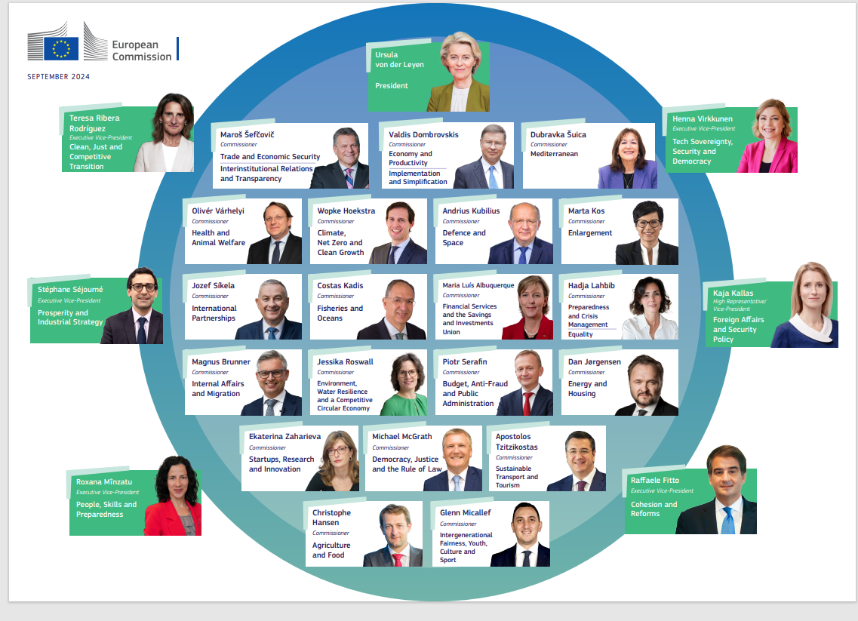
New political EU cycle further EP Elections in June
Notes:
Reduction of budget we moved from 3 Erasmus to 2 each year.
We had one in 2021 on online with 300 participants registered but only 120-150 participants participated. The feedback from participants was very good and very interesting and useful with high quality of speakers and positive impact of the day-to-day work who work with EU Affairs but the programme lose all it's value when it is delivered online.
Permanent Representations expressed their wish that it takes place again in face to face format, as the job shadowing part is the most relevant and interesting one for the participants.

Slide 3
Partnership with EU Institutions
EU L&D network: exchange on main developments in the L&D field, coordinate activities, and inform on EuSA projects
Special network L&D meeting on AI this week
Annual strategic workshop: in-depth reflections on essential areas (purpose of L&D, AI's impact on the profession) and building the community
Involvement of institutions' representatives in 'calls for tenders' evaluation committees
Notes:
Reduction of budget we moved from 3 Erasmus to 2 each year.
We had one in 2021 on online with 300 participants registered but only 120-150 participants participated. The feedback from participants was very good and very interesting and useful with high quality of speakers and positive impact of the day-to-day work who work with EU Affairs but the programme lose all it's value when it is delivered online.
Permanent Representations expressed their wish that it takes place again in face to face format, as the job shadowing part is the most relevant and interesting one for the participants.

Slide 4
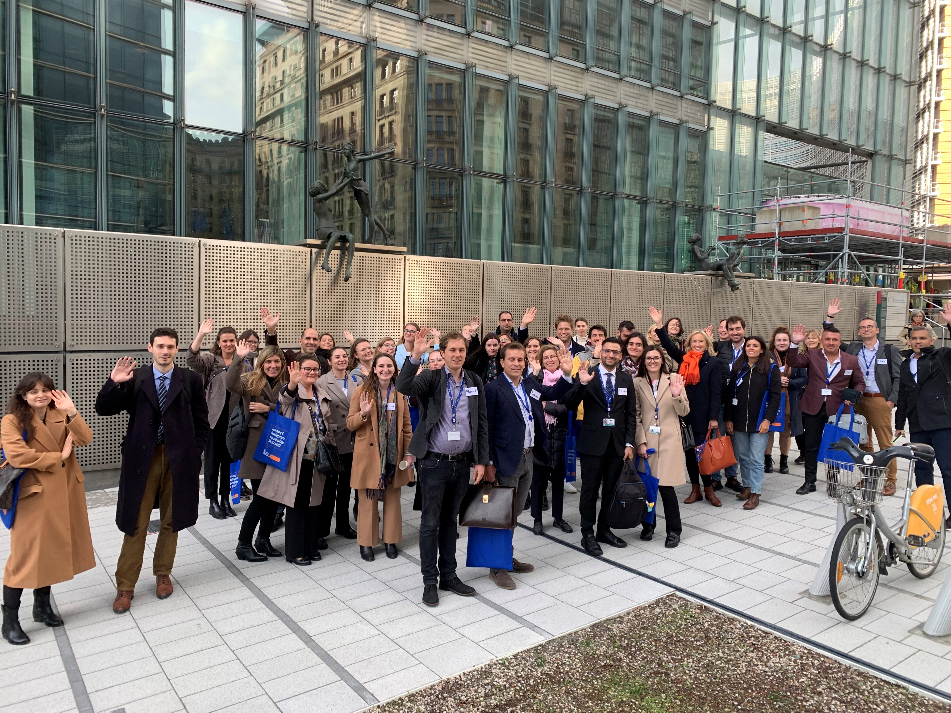
ERASMUS for Public Administrations
“New” officials from National Administrations, spending two weeks in Brussels to learn about the work of the EU institutions
Next session: 18 to 28 March 2025
Deadline for selections: 1 November 2024 Deadline for job shadowing form: 6 Jan. 2025
Promotional video (1.30 min)
Contacts:
EPSO-EUSA-ERASMUS-PUBLIC-ADMINISTRATION@ec.europa.eu
Ann.CHETTLE@ec.europa.eu
Notes:
Reduction of budget we moved from 3 Erasmus to 2 each year.
We had one in 2021 on online with 300 participants registered but only 120-150 participants participated. The feedback from participants was very good and very interesting and useful with high quality of speakers and positive impact of the day-to-day work who work with EU Affairs but the programme lose all it's value when it is delivered online.
Permanent Representations expressed their wish that it takes place again in face to face format, as the job shadowing part is the most relevant and interesting one for the participants.

Slide 5
Induction programme for new EU officials
Stakeholder consultation and collective exchange
Inventory of existing offer in institutions and distil missing features:
Discover the institutions
Sense of belonging in a bigger context
Common values and mindset
Notes:
Reduction of budget we moved from 3 Erasmus to 2 each year.
We had one in 2021 on online with 300 participants registered but only 120-150 participants participated. The feedback from participants was very good and very interesting and useful with high quality of speakers and positive impact of the day-to-day work who work with EU Affairs but the programme lose all it's value when it is delivered online.
Permanent Representations expressed their wish that it takes place again in face to face format, as the job shadowing part is the most relevant and interesting one for the participants.

Slide 6
Leadership Circle – Global Trends
Senior management event on global trends and foresight
ESPAS report Choosing Europe´s Future as inspiration for interactive sessions
Notes:
Reduction of budget we moved from 3 Erasmus to 2 each year.
We had one in 2021 on online with 300 participants registered but only 120-150 participants participated. The feedback from participants was very good and very interesting and useful with high quality of speakers and positive impact of the day-to-day work who work with EU Affairs but the programme lose all it's value when it is delivered online.
Permanent Representations expressed their wish that it takes place again in face to face format, as the job shadowing part is the most relevant and interesting one for the participants.

Slide 7
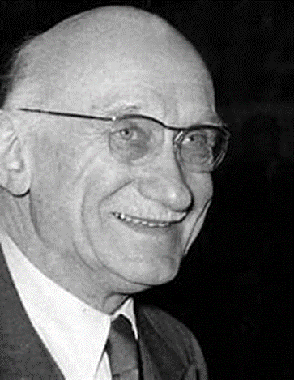


Leadership seminars for challenging times
Inspiring figures and role models of EU founding fathers and mothers
Seminar Simone Veil
Seminar Jean Monnet
Seminar Robert Schuman
Notes:
Reduction of budget we moved from 3 Erasmus to 2 each year.
We had one in 2021 on online with 300 participants registered but only 120-150 participants participated. The feedback from participants was very good and very interesting and useful with high quality of speakers and positive impact of the day-to-day work who work with EU Affairs but the programme lose all it's value when it is delivered online.
Permanent Representations expressed their wish that it takes place again in face to face format, as the job shadowing part is the most relevant and interesting one for the participants.

Slide 8

Thank you!

