Slide 1

The LUPS and the Hungarian System of Further Training of Civil Servants
Balázs Klotz
Director
Institute for Public Administration Further Training
Slides are made by Gergely Koltányi

Slide 2


Main tasks of the Institute
to develop and provide compulsory training for all public servants (except for a few institutions);
to secure the most effective “learning environment” by creating e-learning platforms and providing online virtual classrooms;
to improve teaching and learning methodologies (on-the-job; action learning) and to foster learning effectiveness;
to provide leadership development and training programs for executives of public administration

Slide 3




Our transfomation story
Where did we start?
The challenge
What was our strategy?
Pillars of the “transformation plan”
Where are we now?
Products, services and results
What have we learned?
Findings

Slide 4

The challenge
Mandatory trainings
Focusing on rules, regulations and academic style knowledge transfer
Mostly self-paced, classic
e-leanring courses with tests
Learning is passive and based on short term memory
Learners hate it,
but complete it as a chore
No motivation to learn, they would rather just complete the courses

Slide 5

What were we really trying to achieve?
Focusing on applied skills
not just plain knowledge
Mostly self-paced, online e-learning courses BUT design for how people really learn – learning experience design
Learning should be active and based on curiosity and challenge
Learners like to grow and want
to learn as much as possible
Learning by inner motivation
not because they have to do it

Slide 6
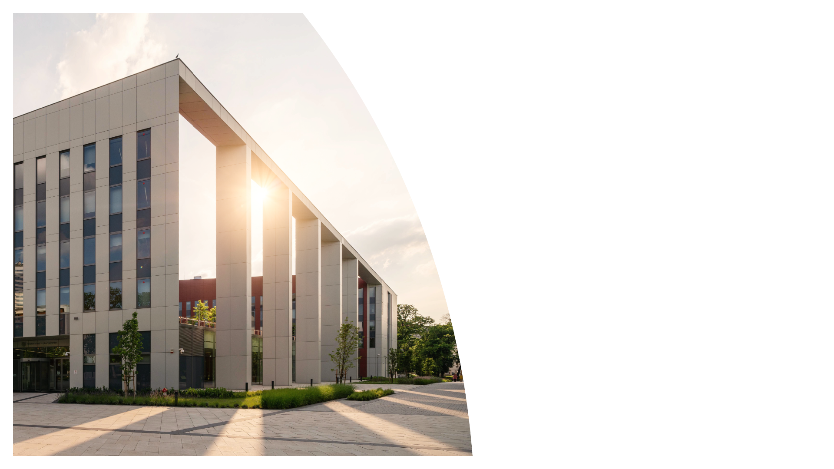
Pillars of the transformation plan
Rethink how we develop training programs
Create a user friendly and easy to use digital learning ecosystem
Learning how to design great learning experiences
Redesign all of the training programs
Understand marketing tactics to “sell” (mandatory) trainings

Slide 7
ProBono
– our new generation
digital learning ecosystem

Slide 8
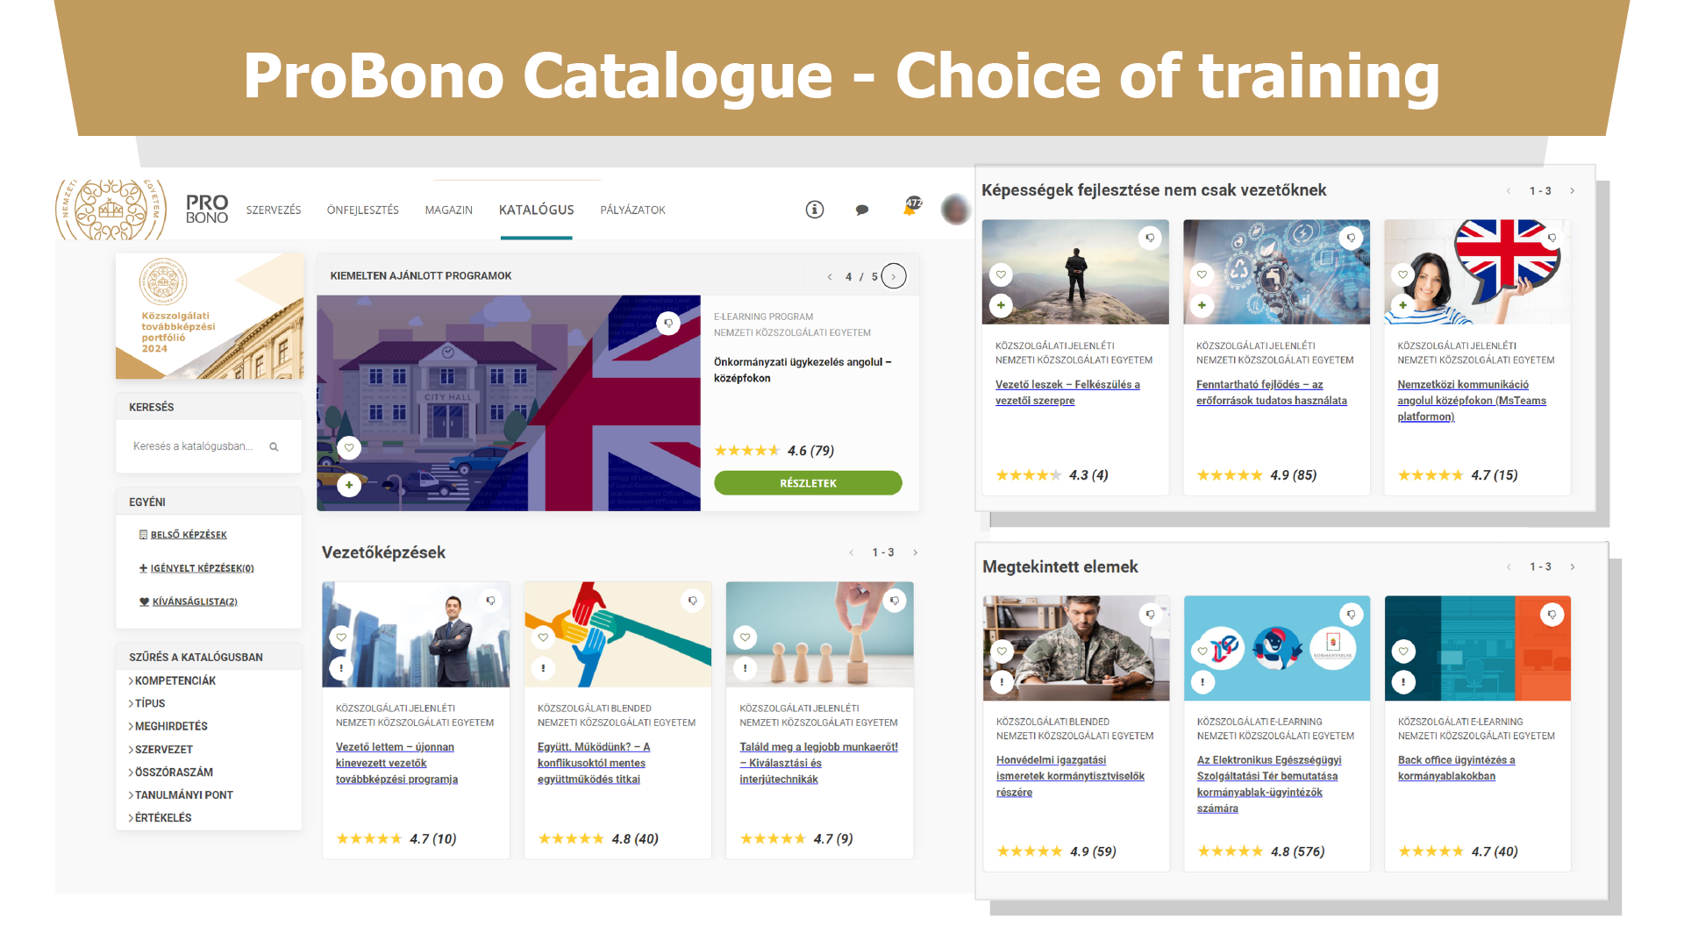

Slide 9
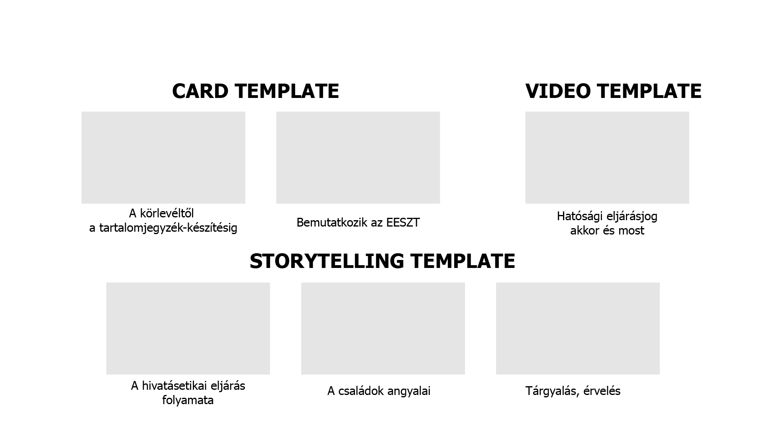

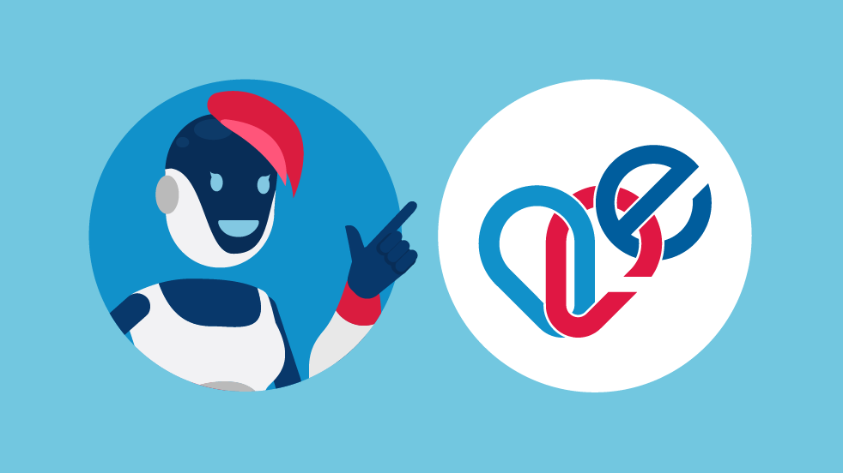

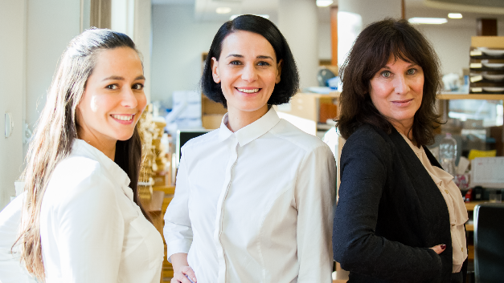


Types of teaching materials

Slide 10

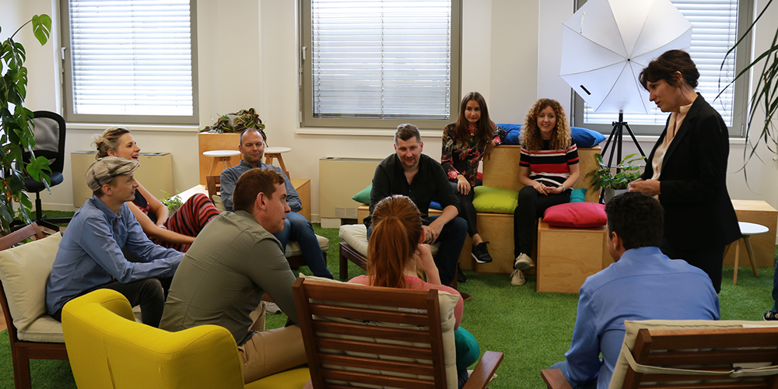

Leadership training simulations
Leadership role
Team building
Cooperation

Slide 11


Where are we now?
Nearly 200 competency-based training programs
New generation digital learning ecosystem
Free access to e-leanring courses
Informal learning opportunities: professional communities and thematic channels
Positive feedback and constantly growing learner satisfaction

Slide 12

What have we learned? - Findings
We do better to support learning
than to force it
Adults can learn independently if they find it really useful and immediately applicable
Focus on practice
rather than exams to develop skills
Positive learning experiences create new learning needs

