Slide 1
Application of Artificial Intelligence to the Planning and Implementation of Training Courses DISPA Budapest, October 2024

Slide 2
Contents
Introduction: Why does the Institute deal with AI?
What courses focused on AI does the Institute offer?
How does the AI help at everyday work and at the course design?
Future visions

Slide 3
Introduction
Institute as leader in training of PA officials in the Czech Republic
Necessary to follow trends in training
Evaluate and use interesting and progressive procedures
Faster process of implementation online lectures, VR and AI during the recent period
Different opinions but inevitable phenomenon

Slide 4
Current Portfolio of AI Training Courses
Artificial Intelligence in Your Texts - Creative Writing with Chatbots
Form: face-to-face course
Target group: public administration in general
Contents:
definition and history of AI
AI risks
how can AI help me?
most known AI text generators
how to communicate with AI
examples

Slide 5
Current Portfolio of AI Training Courses
Artificial Intelligence and its Utilization for Graphic Design: Practical Course for Beginners
Form: face-to-face course
Target group: public administration in general
Contents:
definition and history of AI
generative AI and audio
generative AI and pictures
generative AI and videos
tips for creating promotional materials

Slide 6
Current Portfolio of AI Training Courses
Artificial Intelligence as Non-Legal and Legal Term
Form: face-to-face course
Target group: public administration in general
Contents:
introduction to AI
history of AI
mechanisms and utilization of AI
threats and challenges in AI area
legal regulations

Slide 7
Current Portfolio of AI Training Courses
Artificial Intelligence in Administrative Activities
Form: face-to-face course
Target group: persons interested in AI and in charge of administrative activities
Contents:
utilization of AI in administrative activities
legal regulations
digital exclusion
practical examples: trade business – guide; China, USA – criminality predictive systems

Slide 8
Current Portfolio of AI Training Courses
Artificial Intelligence and its Potential in Public Administration
Form: face-to-face course
Target group: senior officials
Contents:
AI essential terms and principles
AI in practice: case studies and examples –AI assistants, AI speed control
AI implementation in public administration

Slide 9
Current Portfolio of AI Training Courses
Artificial Intelligence and its Possibilty of Utilization in Lecturer‘s Work
Form: face-to-face course
Target group: Institute‘s lecturer‘s staff
Contents:
history of AI
principles of functioning
practical samples of most utilized AI application for creating texts, presentations preparation and data displaying

Slide 10
AI Help at Everyday Work and Course Design
AI can ease the work and save time
Even earlier use of online translators –necessary check and stylization modification despite continuous system‘s improval
Voice→ text transcription (Word, Outlook)
Applications for Text to Speech transfer (e.g. Elevenlabs)
Transcript of online meetings or to-do-list arrangement (e.g. Fireflies)

Slide 11
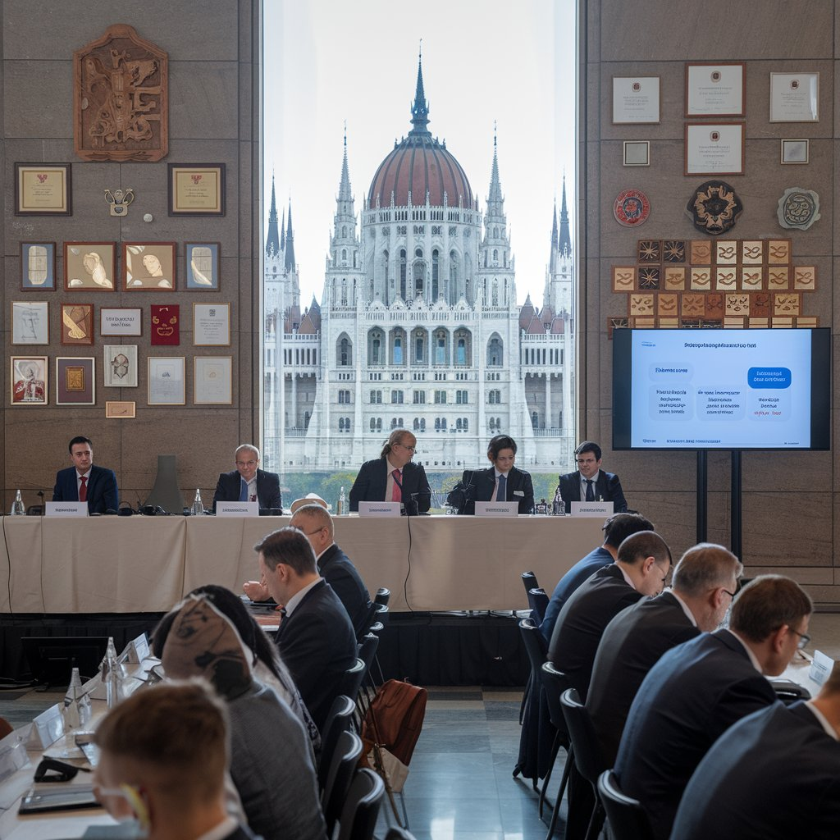
AI Help at Everyday Work and Course Design
Large scale of applications to create illustrative pictures (e.g Ideogram)
Microsoft Copilot – not only for pictures, but for seeking information and generate texts
Promotional materials - e.g Canva

Slide 12
AI Help at Everyday Work and Course Design
Need to be careful when using AI created products and not to violate ethical principles and principles of personality protection
Lot of ethical questions for wider discussion
Example from the meeting with representatives of University of Public Administration Meissen – negative trend of increasing utilization of AI at seminary and final theses

Slide 13
Future Visions
To develop and extend offer of courses focused on AI
To come with a structured catalogue divided into three main domains:
On the Way with AI – From Understanding to Application
Artificial Intelligence as Non-Legal and Legal Term
Artificial Intelligence in Your Texts - Creative Writing with Chatbots
Artificial Intelligence and its Utilization for Graphic Design: Practical Course for Beginners
Potential of AI in Public Administration
AI and its Potential in Public Administration
AI in Administrative Activities
AI as Help in the Office
Generative AI as Help in the Office (Word, Excel, PowerPoint, Outlook etc.)
AI in Particular Administrative Activities

Slide 14
Future Visions
Ready to response demand and suggestions of target groups
Extend contents and portfolio of training courses
Ambition to provide with informational support at setting ethical and legislative conditions for using AI

Slide 15
Thank you for your attention
Lukáš Jirsa
Head of Development and International Cooperation Department
l.jir@institutpraha.cz
+420 736 610 244

