Slide 1



DISPA 2025
Warsaw
Małgorzata Bywanis-Jodlińska, Director
Poland’s National School of Public Administration

Slide 2
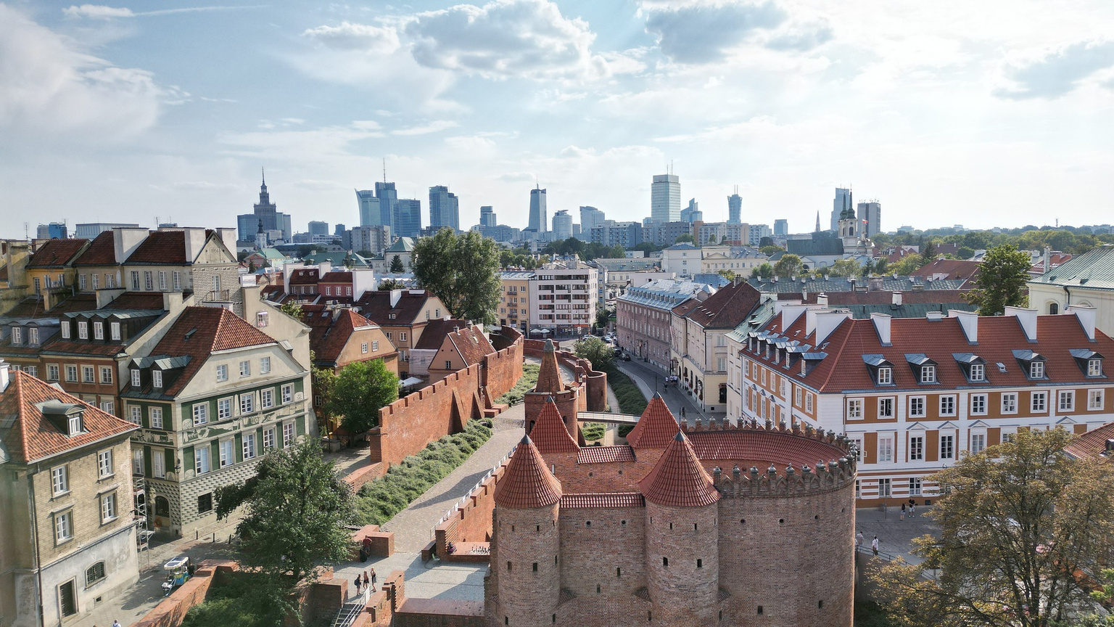
DISPA 2025
WARSAW
May 21 – 23, 2025
National School
of Public Administration
Wawelska 56 Str., Warsaw
www.ksap.gov.pl
www.ksap.gov.pl/ksap/en

Slide 3

Public leadership for resilient state

Slide 4

Goals & Aim
Search for inspirations on how public administration leaders can contribute to building state’s resilience.
Discover innovative leadership approaches to building resilient public institutions.
Discuss the role and skills of public administration leaders in the context of strengthening public administration institutions in turbulent times.
Get strategic insights to improve our school’s/institute’s training and development practices in preparing leaders to meet the challenges of turbulent reality.

Slide 5



Warsaw
will rock you!

Slide 6


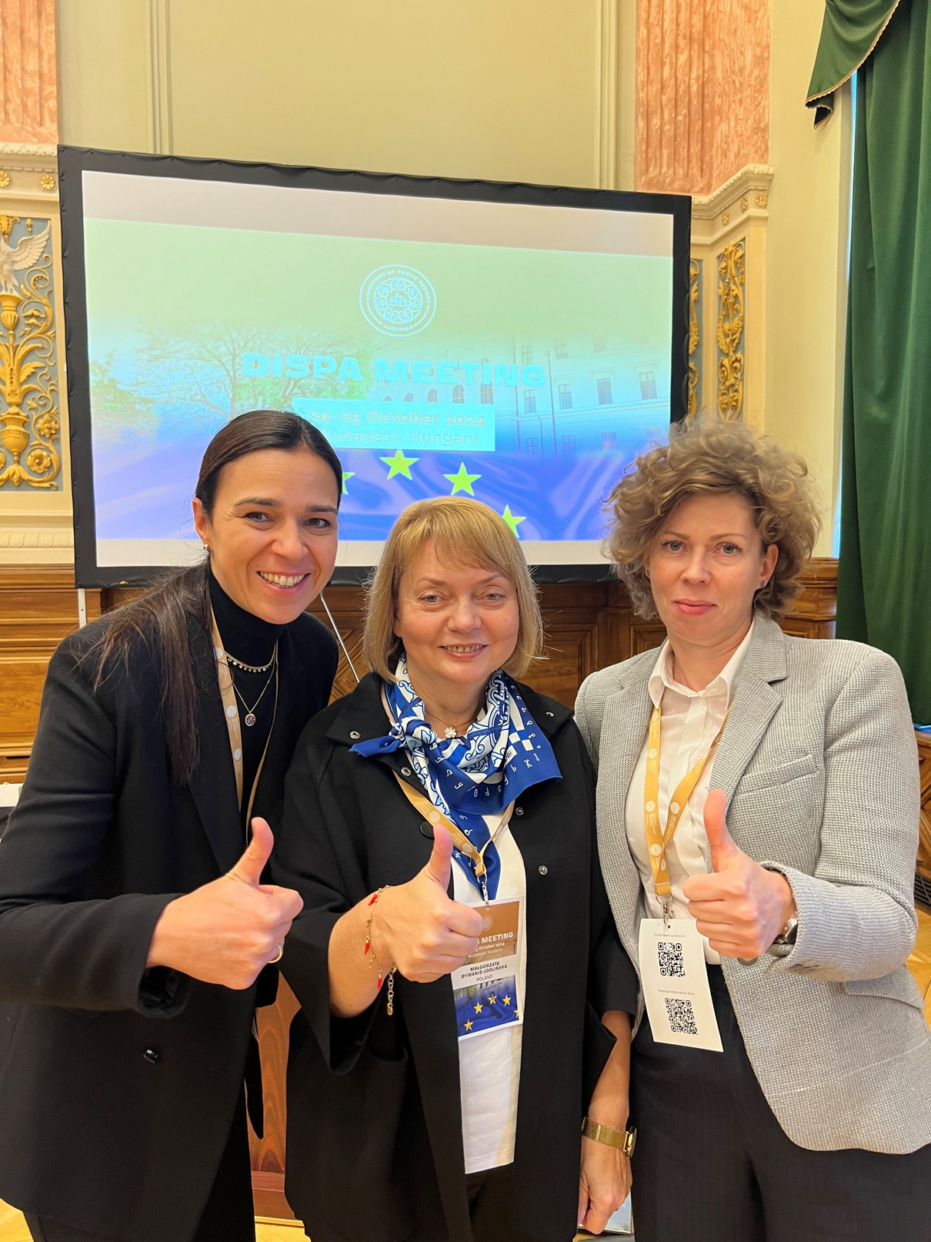
Contact Us
E-mail
Social Media
dispapl.2025@ksap.gov.pl
@krajowaszkola
Website
Address
www.ksap.gov.pl
Wawelska 56 Str., Warsaw, Poland

