Slide 1
Application of AI in training evaluation, Development and application of AI chatbot

Slide 2
Are you using AI now?

Slide 3
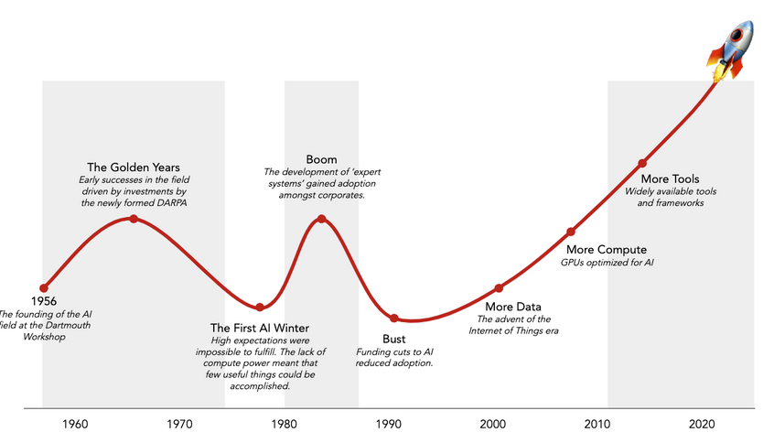
Not everything is recent. This is an inhuman revolution.

Slide 4
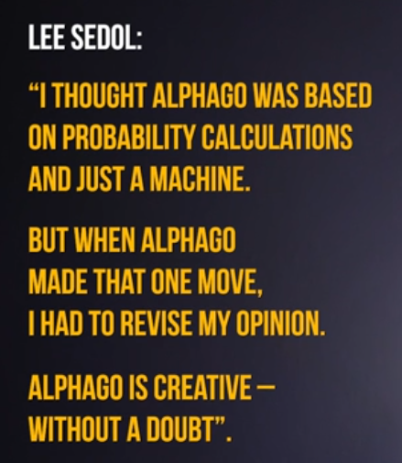
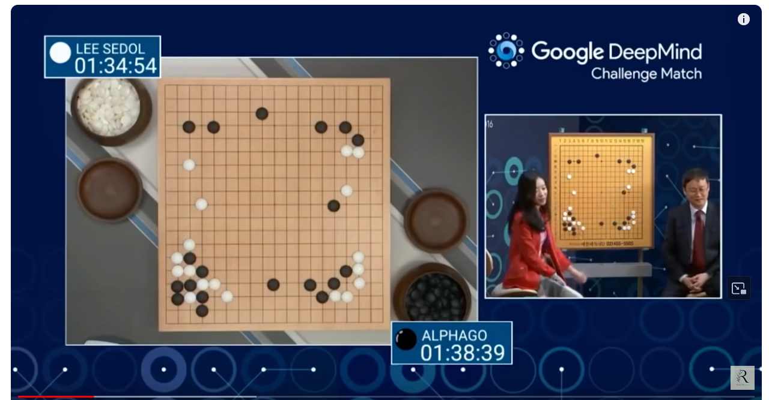
The turning point - Move 37 of Alpha Go
Not only studying games and calculating probabilities but playing against itself.
It demonstrated a level of creativity and strategic thinking that was unexpected from an AI​

Slide 5
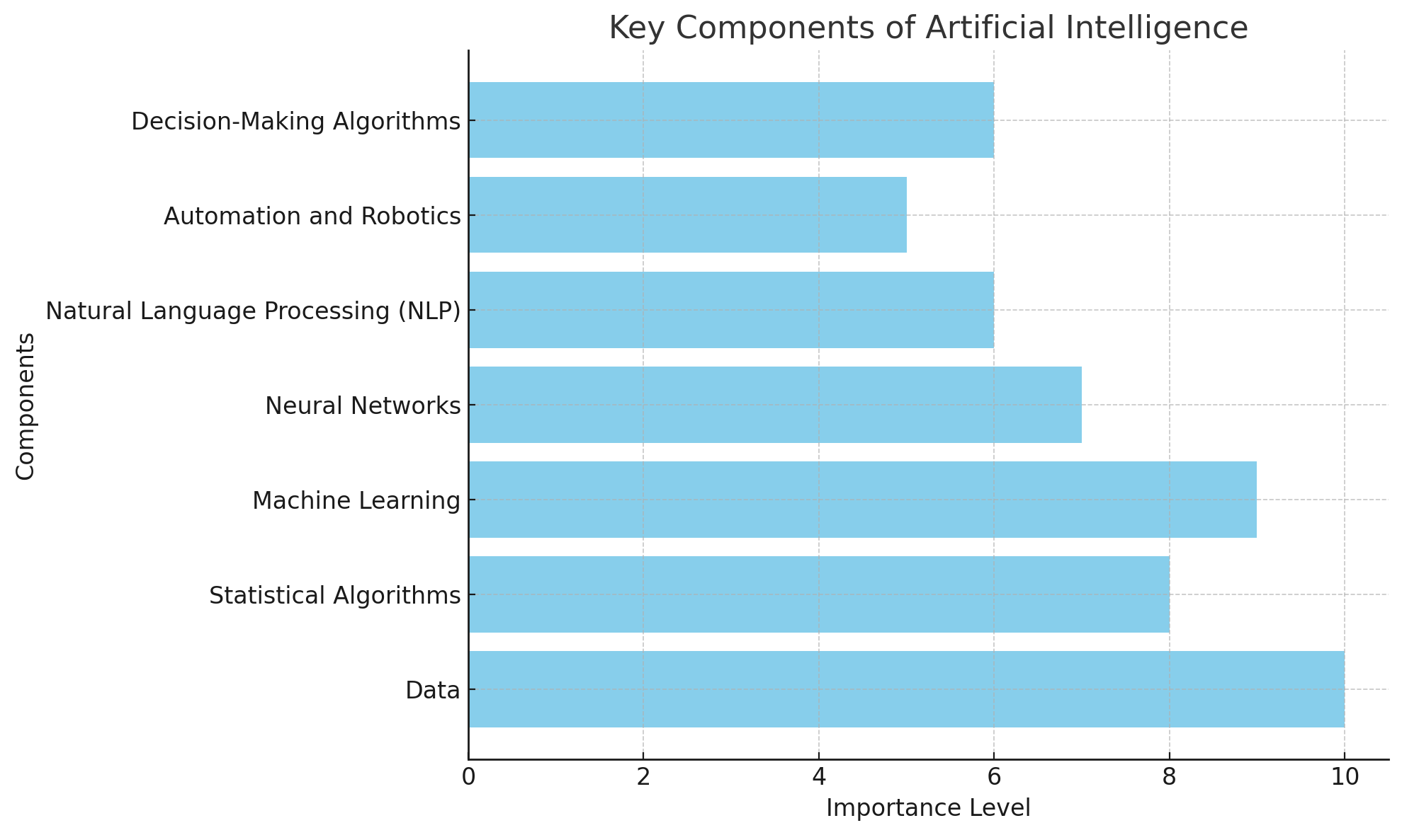
Action
Data Collection
Data Storage
Data analyses
Training of the model
Forecast, Report…
Support for decision

Slide 6
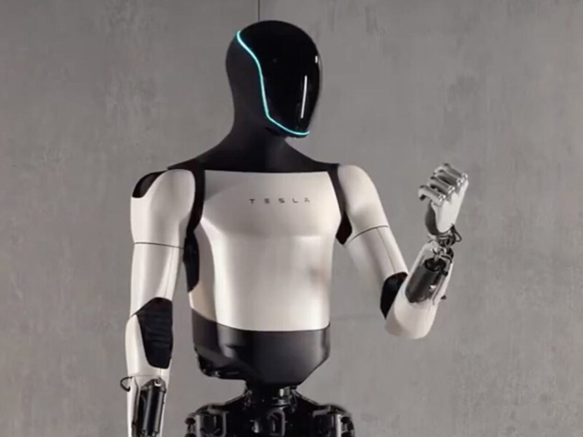
Basic architecture: neural network with mechanism for attention
x ₁
Output
results:
Text
Images
Sound
Video
Code
Input data: raw data (such as text, images, or numerical data
x ₂
y
x ₃
x ₄
Input layer
Hidden layers
Attention Layer
Output layer
10

Slide 7
Basic challenges for AI introduction
1
The results from the AI could be discriminatory
4
A dilemma between individual result and ecosystem stability
2
5
An opportunity for replication of an algorithm (author's rights)
The AI is ineffective with a little data
3
6
Incorrect input data they can confuse the models
The model could be manipulated initially or again after a training

Slide 8
AI-Powered Training Evaluation

Slide 9
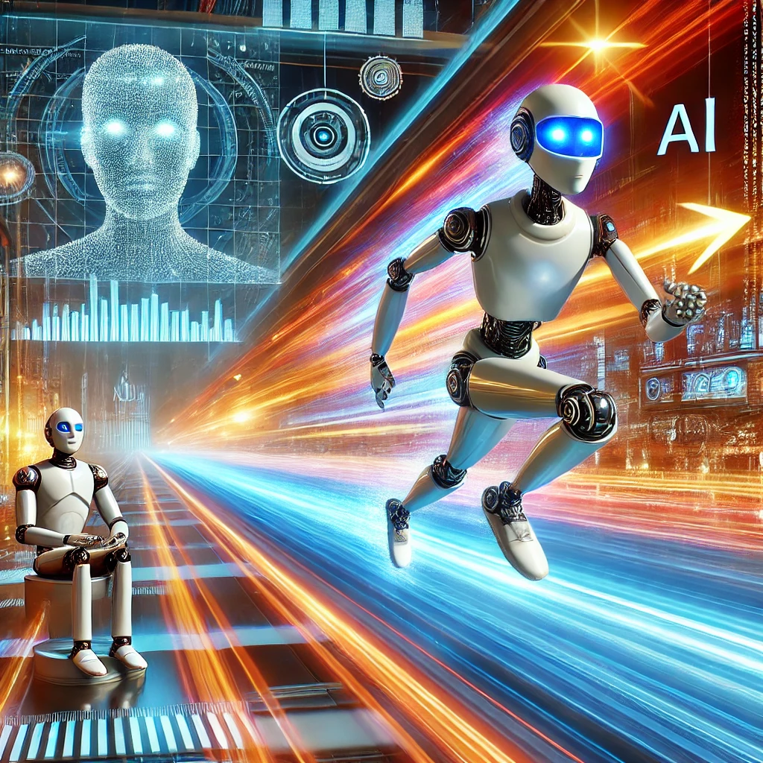
Key Benefits
Real-Time Feedback
Instantly analyse training outcomes and adjust for better effectiveness.
Personalized Learning
AI adapts content based on performance and preferences.
Data-Driven Insights
Extract trends and patterns from feedback for deeper understanding of learner engagement.
Effectiveness
AI-powered evaluation tools can analyse feedback, detect trends, and provide insights on the effectiveness of training programs, helping improve content and delivery.

Slide 10
Meet Yasen Tanev
Highly engaging sessions: Participants praised the interactive and engaging delivery of content.
New knowledge well-received: Most participants agreed they gained valuable, applicable skills. The training enhanced their professional growth.
Clear terminology needed: Some struggled with unfamiliar technical terms and abbreviations.
Extend session duration: Consider offering longer or modular sessions.
More practical application: Participants requested more hands-on examples and exercises. This will reinforce learning through practice.
Digital tools recommended: Some suggested using a computer lab for technical trainings.

Slide 11
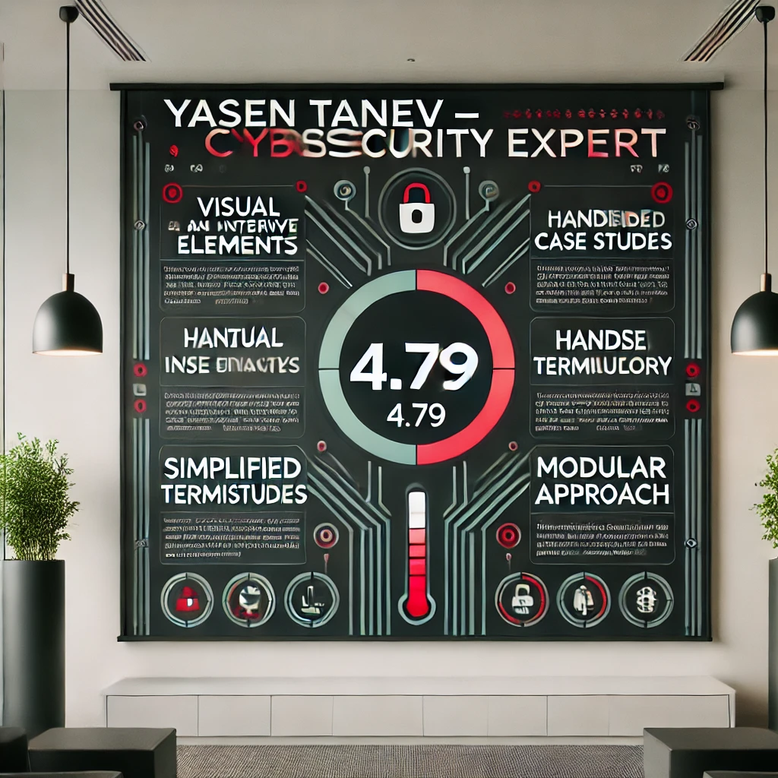
Almost 5, but not really there ☺
The average score for the courses based on participant feedback is 4.79 on a scale of 5. This indicates that the courses are generally well-received, though there is some room for improvement. ​​

Slide 12
How the course will be improved
Add visual and interactive elements Introduce quizzes, challenges, and infographics for engaging, memorable content delivery.
Integrate hands-on case studies Use real-world scenarios where participants apply their knowledge collaboratively.
Simplify technical terms with glossaries Provide pre-training interactive glossaries or flashcards for better comprehension.
Offer modular training sessions Break the course into shorter modules, allowing more reflection and application.

Slide 13
Use case: Evaluation of digital skills for trade attachés

Slide 14
Digital skills assessment
Combining strong human intelligence and AI to create a unique digital skills assessment tool for a specific group of people
Ipa

Slide 15
Use case: The IPA's training data is cross-referenced with other government data.

Slide 16
Huge challenges ahead
Get a clear picture of the state of investment in HR by combining training data, public financial data and headcount with Power BI.

Slide 17
Application of AI chatbot

Slide 18
Say hello to чИПА (chIPA) ; )
(the chatbot of IPA)

Slide 19
AI chatbots can streamline interactions by automating routine tasks, such as responding to frequently asked questions, assisting with training materials, and guiding users through administrative processes.

Slide 20
The idea
How it started?
When it started?
How it was going (initially)?
How it was going (later)….
Who was involved?
How is it going now?

Slide 21
The model
1. Defining the Chatbot's Purpose
Start with a clear objective for the chatbot.
In our case, the bot is used for Q&A and training and will assist users with answers via ChatGPT and a vector database.
2. Choosing the Chatbot Model
Set up a VPN Server, configure an API requests, we are using OpenAI API, which means the bot will be trained to understand and respond to text-based questions in natural language. Cheap solution. Graphic cards>more euros.

Slide 22
3. Creating the Bot’s Role
Define the chatbot’s role – what tasks will it perform, and what tone will it use?
Prompt Engineering: „You are the chatbot of the Institute of Public Administration". Only answer questions related to public policies and training for public officials. Do not answer questions on unrelated topics.
Prompt Engineering: "I'm only able to answer questions related to public administration, policies, training and procedures of the Institute of public administration. Please rephrase your question within these topics."

Slide 23
4. Integrating a Vector Database
A vector database stores information and allows fast retrieval of relevant data.
This enables the bot to fetch contextual information and improve the accuracy of answers based on previous data or knowledge.
5. Fine-Tuning the Model
The model can be fine-tuned with specific data related to your domain or organisation.
This helps the bot understand the nuances and specific needs of your training goals.

Slide 24
6. Setting Sensitivity Level
We have set Sensitivity Level 7.
This defines how "sensitive" the bot is to variations in user queries, meaning it can be more attentive to specific questions or nuances. Level 7 on a scale from 1 to 10 - well above average—competent and confident, but without needing to achieve perfection
7. Testing and Optimization
Once the bot is created, it should be tested with a variety of questions and scenarios to ensure it responds adequately.
Make adjustments to settings or the database as needed to improve its performance.

Slide 25
8. Deployment and Maintenance
After successful testing, the bot can be deployed in a real environment.
Continuous monitoring and database updates are key to ensuring that the chatbot provides relevant responses over time

Slide 26
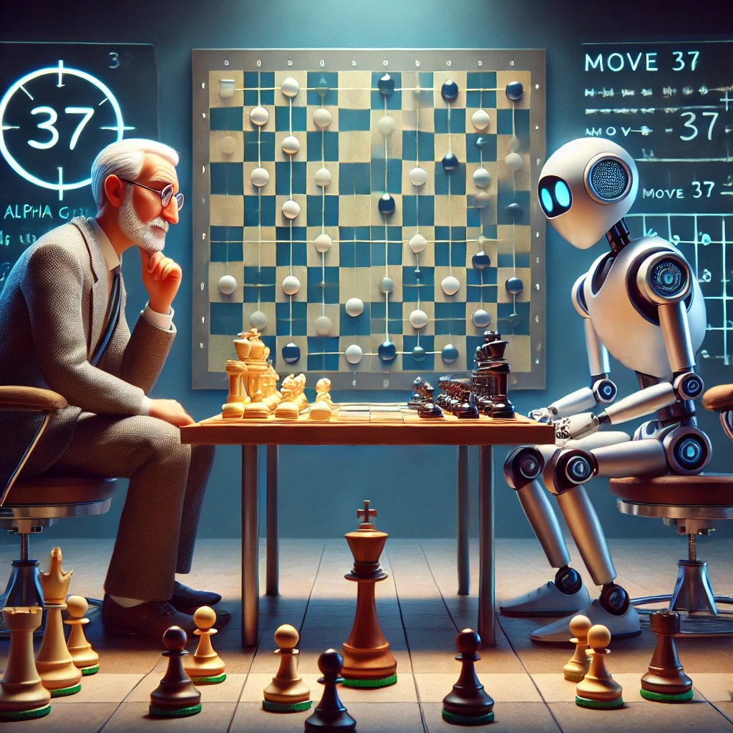
Ethical and Social Implications of General AI
Key considerations
Workforce Impact
How will human roles evolve alongside AI?
Data Privacy
Concerns over privacy, ownership, and consent in AI usage.
Bias and Fairness
Addressing algorithmic biases to ensure fairness in decision-making.

Slide 27
Compensates the lack of qualified personnel.
Supports routine tasks and saves time.
Gives confidence and supports junior positions.
Learns from our habits and anticipates our needs.

Slide 28
Some ideas!
Writing letters, memos, orders…
after the workshop

Slide 29
Thank you!

