Slide 1
Digital Citizen – Artificial Intelligence in Public Service
presented by:
dr. Péter Domokos
political advisor
Cabinet of the State Secretariat Responsible For Regional Public Administration
Ministry of Public Administration and Regional Development
Hungary

Slide 2
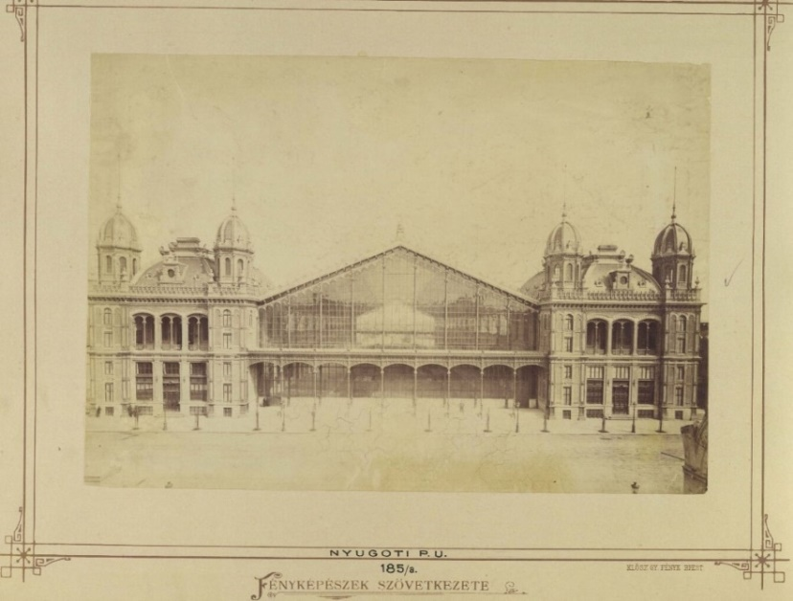
The Western Railway Station, Budapest

Slide 6
1 million+ clients / month

Slide 7
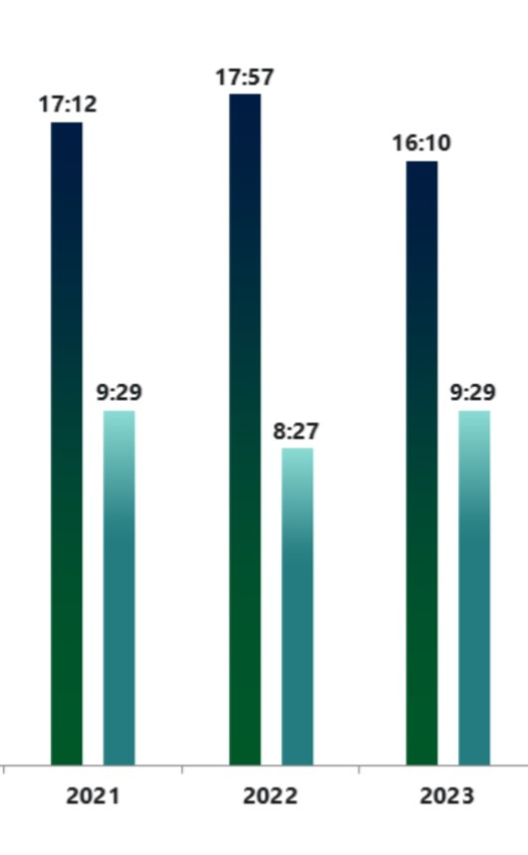
actually not like „Flash” the Sloth…

Slide 8
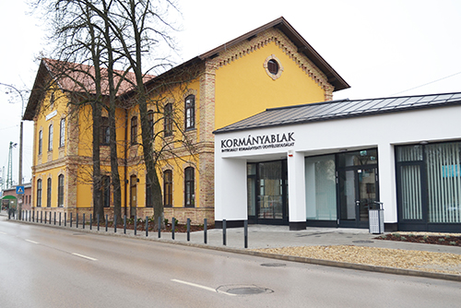
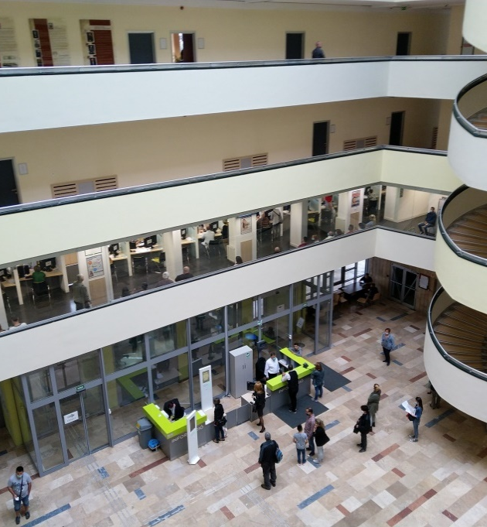
Government Service Centres in Hungary

Slide 9
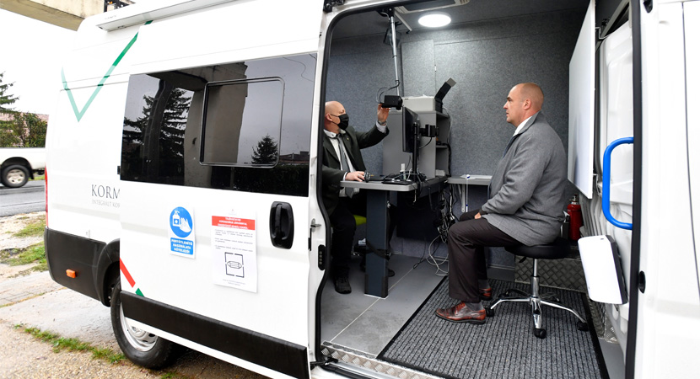
Mobile Government Service Centres

Slide 12
HOW CAN AI SUPPORT PUBLIC SERVICES?

Slide 13
AI can significantly enhance public services in various ways, including:
Efficiency in Administration: Automating routine administrative tasks (like application processing and form filling) reduces workload, errors, and speeds up operations.
Enhanced Citizen Engagement: Chatbots and virtual assistants can provide 24/7 support for citizens, answering questions and guiding them through services.
Personalized Services: AI can tailor public services based on individual needs, improving user satisfaction (e.g., personalized health recommendations or life events).
Data-driven Decision Making: Analyzing vast amount of data to help authorities make informed decisions.
Summary Procedures: decisions can be made made on the basis of statements and evidence presented, without a trial
Education: AI can provide personalized learning experiences in public education systems, adapting to individual student needs and learning paces.
Etc.etc..

Slide 14
EVOLUTION…
The purpose of AI is to strenghten a person’s intellectual abilities, and not to replace them!

Slide 15
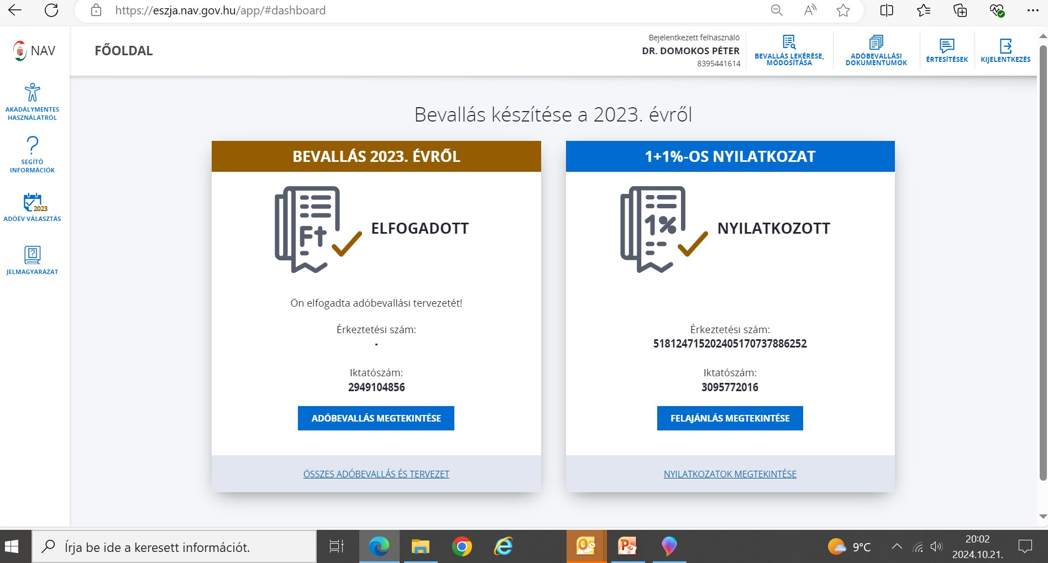
Efficiency in bureaucracy

Slide 16
automated decision-making

Slide 17
…from september 2024:

Slide 18
program pillars
Digital citizenship
Utilization of state data assets
Implementing modern cloud technology
Establishing a positive user experience
Each registered user will have a unique ID to manage cases online and offline.
Private cloud service based on
established technology providers;
usage-based billing
Mobile application and interactive
digital administration leveraging
research results

Slide 19
LEGAL FRAMEWORK
The Hungarian Parliament adopted the Digital Citizen Act on digital state and rules of providing digital services (Act).
The legislative environment was created based on a complex set of criteria.
The Act aims to create digital citizenship itself legally, on which framework user-friendly digital administration and government services can be established.
The next steps involve the fine-tuning of sectoral legislation and the preparation of executive decrees.
Spring of 2024: first amendment to the Law, most important decree-level legislation.
This is followed by the creation of detailed rules at the executive decree level, and the amendment of other decree-level legislation, which is expected in the fall of 2024.
2023
2024

Slide 20
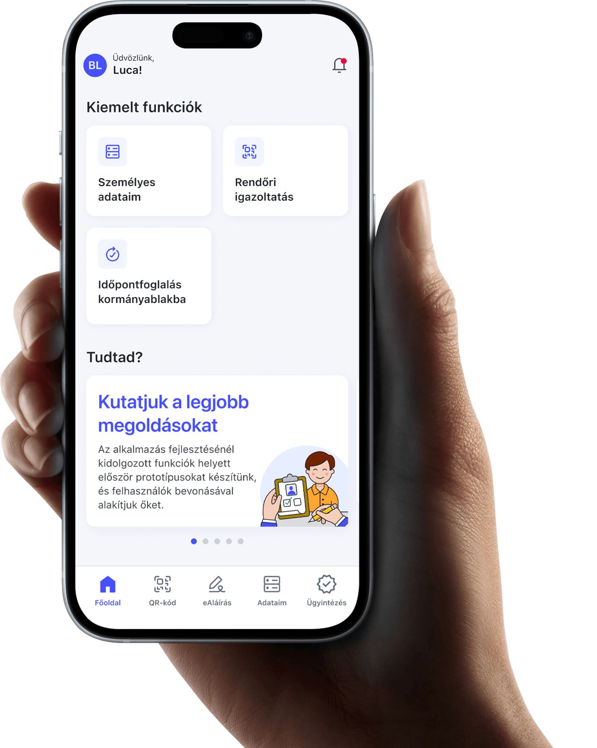
CENTRAL MOBILE APPLICATION
Hungarian citizens can now manage their administrative affairs with ease and speed using a new mobile application.
This application provides a single platform for users to view their data and documents and manage their motor vehicle, family policy, or tax matters.
Businesses can also use this central mobile application for identification purposes in banking or insurance. It can also help manage specific affairs related to public utilities.

Slide 21
ORGANIZATIONAL FRAMEWORK, STANDARDS
The government has established service standards to ensure citizens have a positive experience while using their digital services. To achieve this, design and development guidelines and toolkits will be published for public administration actors.
Public digital platforms will be standardized to make the design and logic of systems more similar and manageable.
In addition, user behavior will be measured, and citizens' needs, as well as the way they use online interfaces of public administration bodies, will be analyzed.
To support these efforts, the Digital Services Center will be established, which will include an Analytics Center.

Slide 22
timing 2024
Timing | 2024
What is available to citizens? | Digital Citizen via mobile application domestic identity check by police (eliminating the need for carrying physical ID cards) data is collected in an authentic and downloadable form managing the most common cases (applying for a certificate of good conduct, booking an appointment at the government customer office) secure digital identification and signature
How many users are expected? | 400.000
What does the public administration do? | Creating design and technological standards guarantees a consistent appearance and usability

Slide 23
timing 2025
Timing | 2025
What is available to citizens? | Everyone who has registered for the service will have one ID and can handle cases with it administrative cases, which is above 10,000 cases per year, can be managed digitally One pilot significant life event can be entirely managed through mobile devices, such as purchasing a car or giving birth Digital identification and signatures can be utilized for market services
How many users are expected? | 2.000.000
What does the public administration do? | It processes and accepts all requests digitally

Slide 24
timing 2026
Timing | 2026
What is available to citizens? | ePost account: electronic communication replaces physical mail for letters, warranty cards, and utility bills ePayment enables you to pay for public services and utilities with just a single click
How many users are expected? | 3.000.000
What does the public administration do? | Public administration organizations are required to respond using ePost
…and what about the future?

Slide 25
„… your future hasn’t been written yet. No one’s has! Your future is whatever you make it. So make it a good one!”
Doc Emmett Brown

Slide 26
„…Look to the future and measure the present with by what you wish to achieve
Do, create, enrich, and the country will arise.”
Ferenc Kölcsey, 1831
Thank you for your kind attention!
peter.domokos@ktm.gov.hu

