Slide 1
Usage of AI in the Scientific Research Practice
Lieutenant Colonel Dr. Ferenc Petruska
University of Public Service
Faculty of military Science and officer training
associate professor

Slide 2
Lt. Col. Dr. Ferenc Petruska
JOBS AND ASSIGNMENTS
2019- | University of Public Service, Faculty of Military Science and Officer Training, Department of Defense Law and Administration - head of department, associate professor
2017-2019 | University of Public Service, Faculty of Military Science and Officer Training, Department of Defense Law and Administration - assistant professor
2015-2017 2012-2015 2011 2010 2007-2010 2007 2005-2006 2001-2005 2001 | University of Public Service, Faculty of Military Science and Officer Training, Department of War - assistant professor University of Public Service, Faculty of Military Science and Officer Training - legal advisor and appointed instructor Miklós Zrínyi National Defense University - senior legal advisor and acting instructor Miklós Zrínyi National Defense University - economic legal advisor HM Department of Defense Planning and Asset Supervision - legal advisor HM Development and Logistics Agency - legal advisor HM International and Event Organization Office - legal advisor MH 1st “Honvéd” EOD and Warship Regiment - legal and administrative chief MH 1st “Honvéd” EOD and Warship Regiment- legal officer

Slide 3
The motto of my presentation
If we are all going to be reading and writing with artificial intelligence tomorrow,
we shouldn't wait for today.

Slide 4
The aim of my presentation
From the beginning of 2023, artificial intelligence (AI) will have significantly expanded its capabilities and possibilities in the university environment. The workshop I am preparing will provide an opportunity to learn more about the latest developments, capabilities and application strategies of Large Language Models (LLMs), as well as to share professional experiences and ideas. My presentations will also provide a detailed analysis of the privacy and copyright challenges of AI.
The workshop aims to help you to:
Learn about the latest and most prominent language models;
Find out which of these skills work in Hungarian;
They apply a sophisticated process of building on each other;
To create a forum where they can share our experiences and thoughts on AI.

Slide 5
Is this all just hype?

Slide 6
"And finally there is the mother of all technologies - artificial intelligence - where machines actually develop the ability to learn and think."
"These developments, rapidly converging in space and time, are leading to this profound change - the most profound change ever seen in human history. And whatever predominance we, the United States, enjoy militarily ... the United States is challenged in all domains of warfare: space, cyber, maritime, air, and land."
General Mark Milley
the US Joint Chiefs of Staff
Chairman of the Joint Committee
Notes:
"And finally there is the mother of all technologies - artificial intelligence - where machines actually develop the ability to learn and think." "These developments, rapidly converging in space and time, are leading to this profound change - the most profound change ever seen in human history. And whatever predominance we, the United States, enjoy militarily ... the United States is challenged in all domains of warfare: space, cyber, maritime, air, and land."

Slide 7
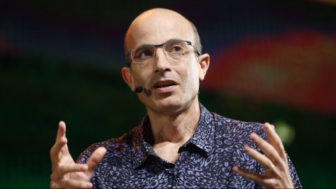
"What will happen to the course of history when AI takes over culture and begins to produce – ie invent – stories, melodies, laws and religions? Earlier tools, such as the printing press and radio, helped spread the cultural ideas of humans, but never created new cultural ideas of their own. The AI is fundamentally different. AI can create completely new ideas, a completely new culture.”
"Artificial intelligence has hacked our civilisation's operating system"
Yuval Noah Harari
Israeli historian

Slide 8
Mo Gawdat (Google X)
AI is no longer an IT tool, but a person;
AI knows „everything we know, and better”;
AI builds his personality from our online hypermasculine posts;
AI is autonomous, intelligent, creative, stays with us, copies you;
We cannot limit AI, because it listens like a child not to the command of programmers but to the essence of our deviant online conversations;
In 2029 (nowadays 2027) there will not be a smarter man on Earth;
AI will be a million times smarter than us. That's the difference in intelligence between Einstein and a fly;
AI will not attack our physical body, but our consciousness;
"Guitar lady", in which she feeds us one-sided information, thus changing opinions and thus society;
AI controls autonomous vehicles and weapons, but AI won't use that against humans.

Slide 9
Artificial intelligence ethics of science

Slide 10
Is it ethical to use AI in research?
Notes:
Stanford University
Stanford University is a private research university in Stanford, California, founded in 1885 by Leland Stanford Jr. and his wife, Jane Lathrop Stanford.
Stanford is regarded as one of the world's top universities and has produced many distinguished alumni, including 30 living billionaires, 18 Turing Prize winners, 27 Fields Medallists and eight astronauts.
The university's motto is "Die Luft der Freiheit weht" (German: "The air of freedom blows"), from the 18th century German poet Friedrich Schiller.
Harvard University
Harvard University is a private Ivy League research university in Cambridge, Massachusetts. Founded in 1636, Harvard is the oldest institution of higher education in the United States and one of the most prestigious universities in the world.
Harvard is known for its liberal arts and science curriculum, strong alumni network and commitment to academic excellence. The university's motto is "Veritas" (Latin for "Truth").
Yale University
Yale University is a private Ivy League research university in New Haven, Connecticut. Founded in 1701, Yale is the third oldest institution of higher education in the United States and one of the most prestigious universities in the world.
Yale is known for its undergraduate liberal arts, law school, and graduate programs in medicine, business and the arts. The university's motto is "Lux et Veritas" (Latin for "Light and Truth").
Johns Hopkins University
Johns Hopkins University is a private research university in Baltimore, Maryland. Founded in 1876 by Johns Hopkins, a wealthy Baltimore merchant, it was the first research university in the United States.
Johns Hopkins is known for its medical school, the Bloomberg School of Public Health and the Peabody Institute, a famous music school. The university's motto is "Veritas vos liberabit" (Latin for "Truth sets you free").

Slide 11
Rie Kudan: Tokyo Sympathy Tower novel

Slide 12
Why do we need large language models (LLMs)?
Huge amounts of rapidly changing data of varying quality;
AI identifies, assesses, decides and structures;
Based on pre-defined, strict criteria;
Immediately;
Autonomously;
24/7
For example, contracts, articles, reports, judgments, decisions, opinions and all literature.

Slide 13
The ten commandments for using Large Language Models

Slide 14
Ten Commandments of LLM
Trap of direct full text typing (LIMA2, ChatGPT) = discrediting
LLMs are not about getting the same quality of work done faster, but much more work done to a significantly higher standard;
Lack of references (Zotero, Citefast, Grammarly, Scispace, etc.)
Lack of paradigm shift = we want to do the same steps as in traditional text writing
Automation of keywords, outline, summary, abstract of writing is lagging behind (Qillbot, Gemini)
The "machine never" and "man always" preconceptions.
Neo-luddism
We observe a state and not a process (3% error)
A racing driver does not have to be a mechanic!
Feel free to use and share your GenAI knowledge!
Notes:
Gorodok Cavalry Charge, 17 August 1914 by the Hungarian Royal 5th Honvéd Cavalry Division, Enemy Commander: "It was a beautiful charge. Congratulations to you. I am a cavalryman and I know what it is. I never thought such a charge could be made today."
Luddism was a particular manifestation of the early English labour movement, and its followers were the Luddites. One of its main features was, but not limited to, technophobic machine-breaking, but it also included a wide variety of forms of struggle with employers: illegal organising, negotiating with employers, rioting, occasional armed confrontations with the authorities, and the destruction of entire factories.

Slide 15
Large Language Models (LLMs) for higher education for higher education

Slide 16
Use of GenAI by students
Understanding difficult concepts (36%)
Summarising or rewording texts (33%)
Providing help with written assignments (32%)
Answering homework (30%)
Analyse or interpret data (28%)
Organising your schedule (21%)
Preparing CVs, cover letters or job applications (21%)
Creating content/ideas for scientific work (21%)
Making practical materials for learning (19%)
Translation of text into another language (17%)
Sources:Tyton Partners analysis: 2023 Autumn Student Pulse survey, Tyton Partners analysis

Slide 17
What can artificial intelligence be used for in research?
Answering questions where the answers are based on material that is openly available on the internet;
Understanding complex material and ideas;
Plan and structure ideas for written work or presentations;
Exploring different writing styles, text structures and approaches, especially academic ones, for different audiences;
Review, evaluation and critical analysis of written material;
Identify and then address problems with scientific writing, grammar, grammatical correctness or structure;
Summaries of notes taken during writings or lectures;
Continuously expanding possibilities (content generation, link searching, text analysis, etc.)

Slide 18
What can artificial intelligence be used for in research?
Source research, translation and citation are almost automated.
Reduces text generation (writing) to a fraction
Authentication remains the more knowledge- and time-intensive task
What can artificial intelligence be used for in education?
Reducing teaching time to a fraction.
Structuring the presentation, creating a language adapted to the audience is the most knowledge- and time-consuming task.
What can artificial intelligence be used for in examinations?
Examinations are almost completely automated.

Slide 20
What are the limitations of research?
Data is not always up-to-date;
Poor at searching for legislation and legislation (§);
If the dataset is biased, this bias will be passed on to the generated content (data poisoning);
Totally incorrect data - hallucination (3-5%);
Extracting data from source articles in Hungarian is not yet perfect. Reason: over 80% in English, 0.3% "taught" with Hungarian text.

Slide 21
Legal consequences of plagiarism and AI-generated text
Plagiarism
Plagiarism: unauthorised use or misappropriation of another's intellectual property
There are serious legal consequences (e.g. reparation, public satisfaction, conferral of a pecuniary advantage, judicial declaration)
Text generated by "AI"
Percentage of AI source probability detected
No copyright work is created = no copyright protection = as if nothing had been created
If you quote from an existing work: you may be committing plagiarism
Higher education institutions may also impose additional legal consequences

Slide 22
CONCLUSIONS
We will never write a thesis, a dissertation or any kind of submission with an AI-based interface!
The content you create is a perfect springboard, but you are not allowed to publish it without changes.
Let's use these as a first draft, which can be enriched with minimal editing and creative ideas → "human-faced" content.
At best, its role is limited to translation, brainstorming and data collection.

Slide 23
Software designed for academic use, which is powered by artificial intelligence.

Slide 24
Source Works

Slide 25
Google Scholar - search for resources using keywords and simple terms

Slide 26
Sourcely - source search by title, by phrase

Slide 27
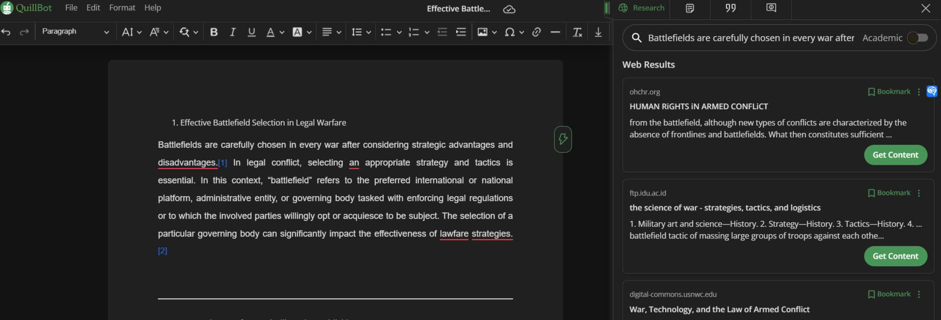
Quillbot - source search for full text

Slide 28
Scite - search for full text sources

Slide 29
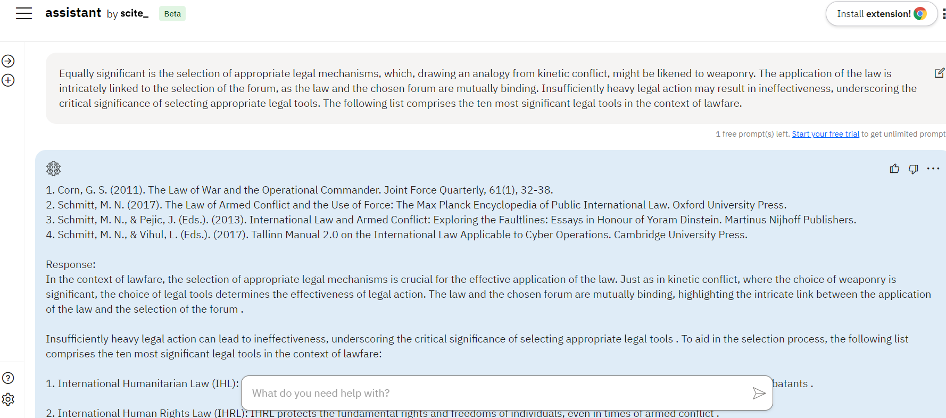
Scite - search for full text sources

Slide 30
SCISPACE - questions and resource search for text

Slide 31
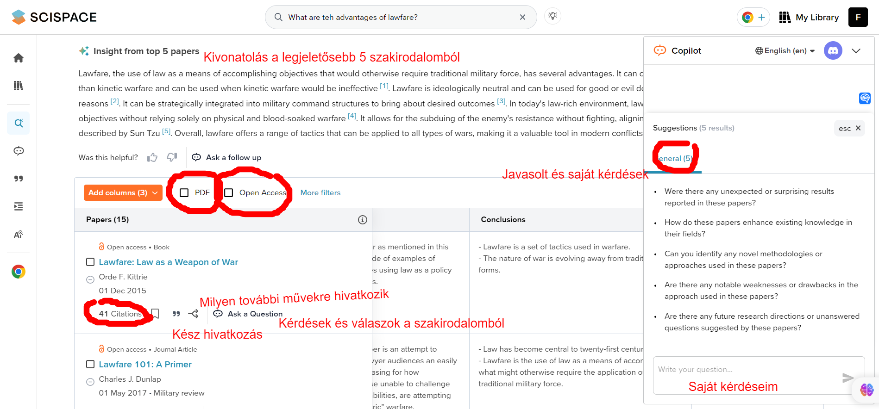
SCISPACE - questions and resource search for text

Slide 32
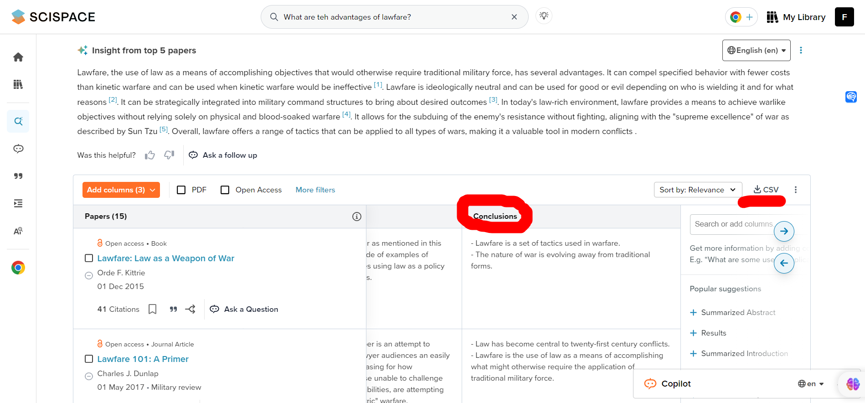
SCISPACE - questions and resource search for text

Slide 33
SCISPACE - questions and resource search for text

Slide 34
SCISPACE - questions and resource search for text

Slide 35
SCISPACE - questions and resource search for text

Slide 36
SCISPACE - questions and resource search for text

Slide 37
SCISPACE - questions and resource search for text

Slide 38
SCISPACE - intelligent reading

Slide 39
SCISPACE - Smart Reading (English-Hungarian)

Slide 40
SCISPACE - intelligent reading with source tagging

Slide 41
SCISPACE - Text content analysis

Slide 42
SCISPACE - Formal analysis of text

Slide 43
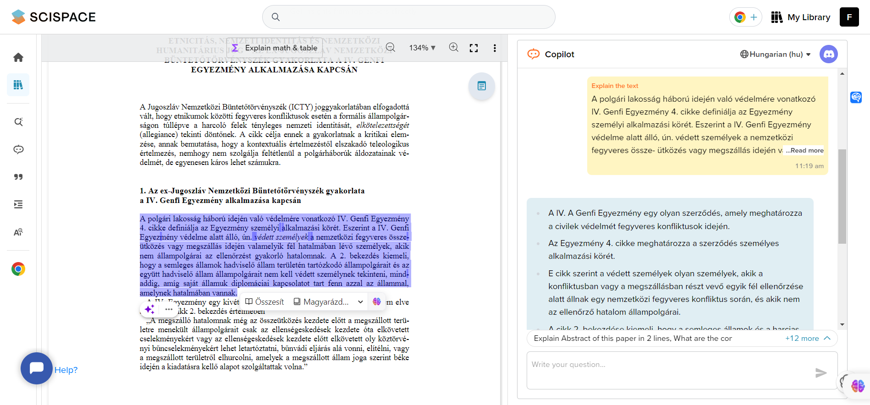
SCISPACE - works in English

Slide 44
Scispace - text analysis

Slide 45
Scispace - text analysis (2)

Slide 46
Identifying spelling mistakes
After reviewing the sources provided, there are no explicit indications of spelling mistakes in the texts. The excerpts appear to have been proofread and edited, as evidenced by the acknowledgement of the copy editor's care in the volume's foreword [1]. The texts are part of a professionally produced publication, which typically undergoes rigorous editing to ensure accuracy and correctness [2]. In addition, the mention of hyphenation correctness in several contexts suggests a focus on the correct use of hyphens as a component of spelling and grammatical accuracy [3] [4] [5] [6] [7] [8]. However, without explicit examples of misspelled words or a directive to correct specific spelling errors, it is not possible to list a list of spelling errors that arise from a given context. The texts appear to meet the standards expected in academic publishing, where spelling and grammatical accuracy are paramount [9] [10].
Spelling and writing assessment of the Hungarian text
The Hungarian excerpts in the sources are free of spelling and punctuation marks, reflecting the meticulous quality of academic writing. The Hungarian text follows standard orthographic conventions, including the use of accents and special characters specific to the Hungarian language, such as "ö" and "ü" [1]. Sentences are correctly constructed, with appropriate punctuation, such as commas and periods, according to the rules of Hungarian grammar [2]. In addition, the use of hyphens is requested to ensure correctness, further indicating a careful editing process to maintain linguistic accuracy [3]. Attention to detail in the English text is consistent with the overall quality of the publication, which includes copy-editing acknowledged in the preface [4]. The accuracy of the English segments is consistent with the academic rigour expected in legal and religious discourse, as in the comprehensive treatment of topics such as family law and the status of religious communities [5] [6].
Analysis of punctuation in academic text
Examination of the sources provided indicates that the punctuation is correctly placed in the text. The use of commas, hyphens and dashes adheres to the grammatical rules appropriate to the language of the text, whether English or Hungarian [1] [2] [3] [4] [5]. Attention to hyphenation suggests a particularly rigorous editing process to ensure the accurate structure of complex words and phrases [2] [4] [5]. Furthermore, the Hungarian-language texts maintain the linguistic standards expected of academic writing, with correct punctuation in line with the orthographic conventions of the Hungarian language [1] [2] [3]. Issues of correctness of in-text hyphenation further reflect a commitment to linguistic accuracy [2] [4] [5]. Editorial acknowledgements in the preface to the volume emphasise the care of copy-editing, which would include checking for correct punctuation. This meticulous approach is in keeping with the high standards of academic publishing, where clarity and accuracy are paramount [6] [7]. The sources show no obvious punctuation errors, indicating that the text has probably undergone careful proofreading and editing to meet the expected academic criteria [1] [2] [3] [4] [5].

Slide 47
SCISPACE EXTENSION IN CHROME SEARCH -
Extension slogan: "Hours of research in a few minutes"
Right-click on two options: chat with online sources (EXPLAIN) or collect studies similar to the one you are interested in (RELATED PAPERS)

Slide 48
CONSENSUS - scientific chatbot custom with answers

Slide 49
CONSENSUS - scientific chatbot summarized for answers

Slide 50
Grammarly - flawless grammar, professional style

Slide 51
CITEFAST - error-free links

Slide 52
Deep-L

Slide 53
Deep-L

Slide 54
QuillBot - creating a link

Slide 55
QUILLBOT - summaries

Slide 56
QUILLBOT – smart plagiarism detector (also paraphrasing)

Slide 57
QUILLBOT - paraphraser

Slide 58
Writetone - text writing by topic

Slide 59
Writetone - co-author

Slide 60
Writetone - teacher

Slide 61
Writetone - copywriting by audience

Slide 62
Writetone - other functions (≈Qillbot)

Slide 63
CHITCHAT - text summary

Slide 64
Document analysis

Slide 65
Glarity Summary

Slide 66
Transcript and Summary

Slide 67
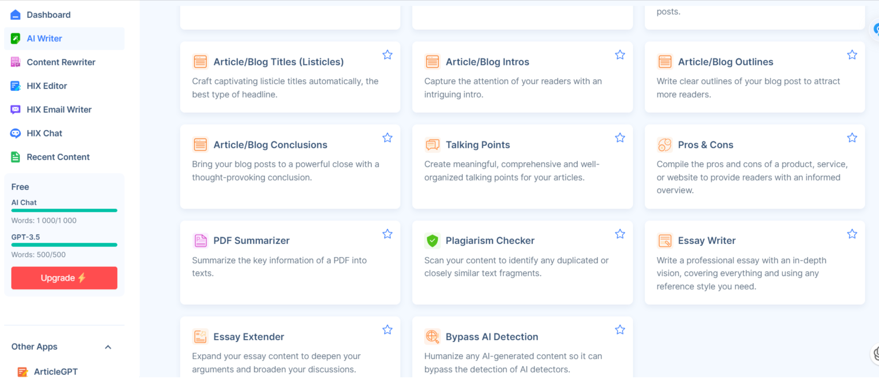
HIX.AI - Swiss Army knife of research (not recommended)

Slide 68
HIX.AI - Swiss Army knife of research (not recommended)

Slide 69
HIX.AI - Swiss army knife of research (not recommended)

Slide 70
DESIGNRR - Swiss Army Knife of writing

Slide 71
Wordgenie AI - writing full books

Slide 72
Textie AI - Hungarian language model

Slide 73
Academic prompt writing

Slide 74
Introduction to Academic Prompt Generation
Academic prompt generation involves creating structured and clear instructions for language models to produce desired outputs.
Which large language model
should I choose?

Slide 76
What should I use the models for at university?
Virtual tutors: chatbots can be used as virtual tutors to support self-learning. For example, chatbots can ask students questions, give feedback on their work and provide motivation.
Online learning support. For example, chatbots can answer students' questions, help them complete assignments, and provide support in case of learning difficulties.
Create and personalise educational content: chatbots can be used to create and personalize educational content. For example, chatbots can generate text, translations, and various creative content. This content can then be used to personalise it for students.

Slide 77
I. ChatGPT
"Unprepared Talent for the Exam", a language model (LLM) chatbot developed by OpenAI. It is one of the most advanced chatbots in the world, taught by tens of thousands of people and used for a variety of purposes, including education and research.
Benefits:
Excellent for generating human-quality text,
It can also translate languages,
write creative content and answer questions in an informative way.
It is constantly updated and improved, so its skills are always growing.
available in many languages..
Disadvantages:
works with old, out-of-date data;
data security issues
hallucination

Slide 78
Scholar Gpt

Slide 79
II. Bing Chat
"Self-Maturing Genius", developed by Microsoft. It is similar in many ways to ChatGPT, but works with Microsoft's GPT-4 language model.
Advantages: Very good at understanding natural language and following instructions; it also generates photos in its reply, and photos can be uploaded; can access and process information from the real world; Available in a number of languages including Hungarian, English, Chinese and Japanese.
Disadvantages: Does not write with perfect Hungarian spelling; It does not use English with poor spelling, but it does not have English spelling, constantly occupies the screen.

Slide 81
III. Gemini
"Senile Professor", developed by Google AI.
Benefits:
Provides three drafts (answers);
the most advanced chatbot of the three, and can perform a wide range of tasks.
It can access and process photos;
matches conversations with search results.
knows Hungarian, but not good grammar.
Disadvantages:
Not as easy to use as ChatGPT or Bing Chat.
Not as good at following instructions.

Slide 83
Gemini

Slide 84
Gemini 1.5 Advanced

Slide 85
Basic Rules for English Prompts
1. Declare the Role
2. State the Main Task
3. Steps to Complete the Task
4. Define the Goal
5. Constraints

Slide 86
IV. ParancsPULI AI

Slide 87
IV. ParancsPULI AI

Slide 89
Text generation

Slide 90
V. MISTRAL LE CHAT

Slide 91
VI. GroqChat – cannon ball

Slide 92
Groq chat

Slide 93
VII. Perplexity AI – The Professor

Slide 96
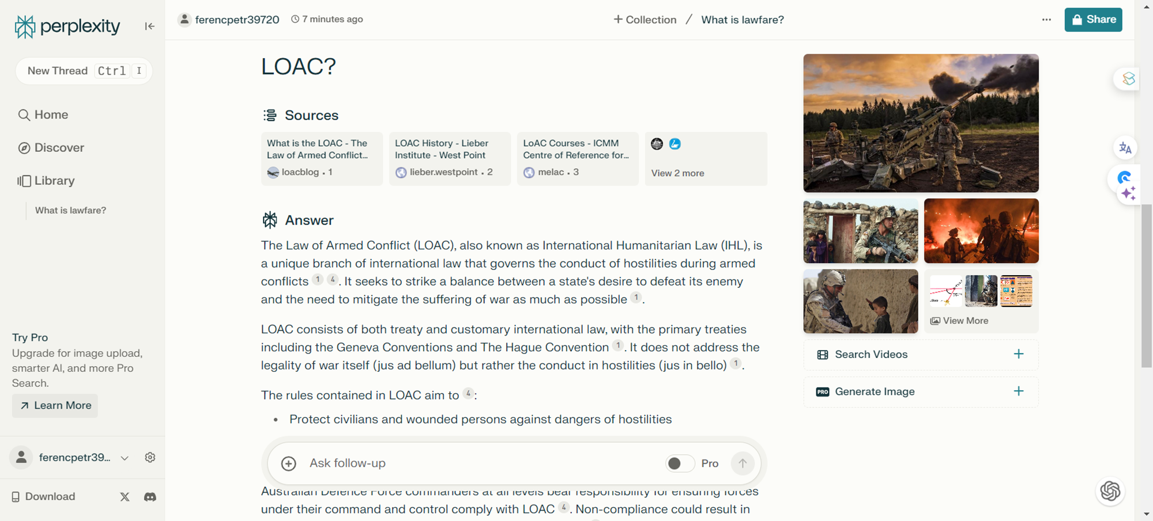

Slide 97
VIII. You.com

Slide 99
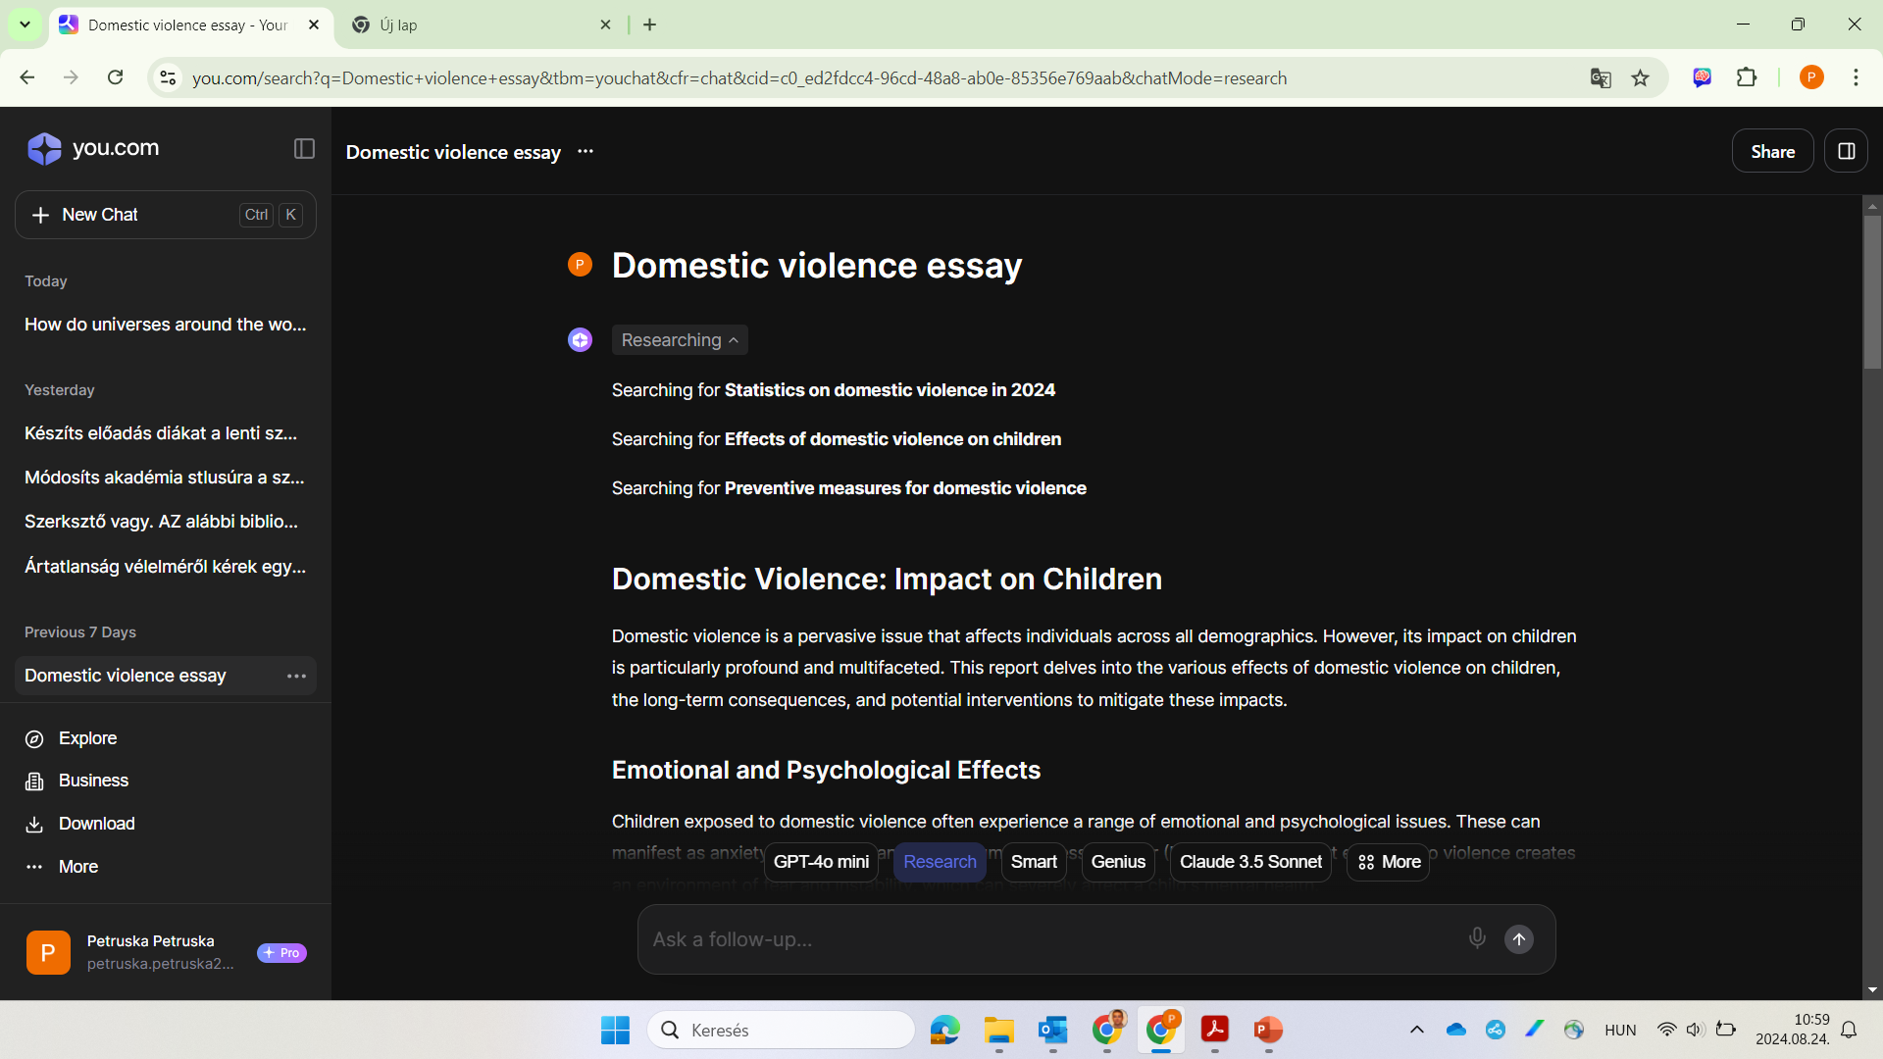

Slide 100
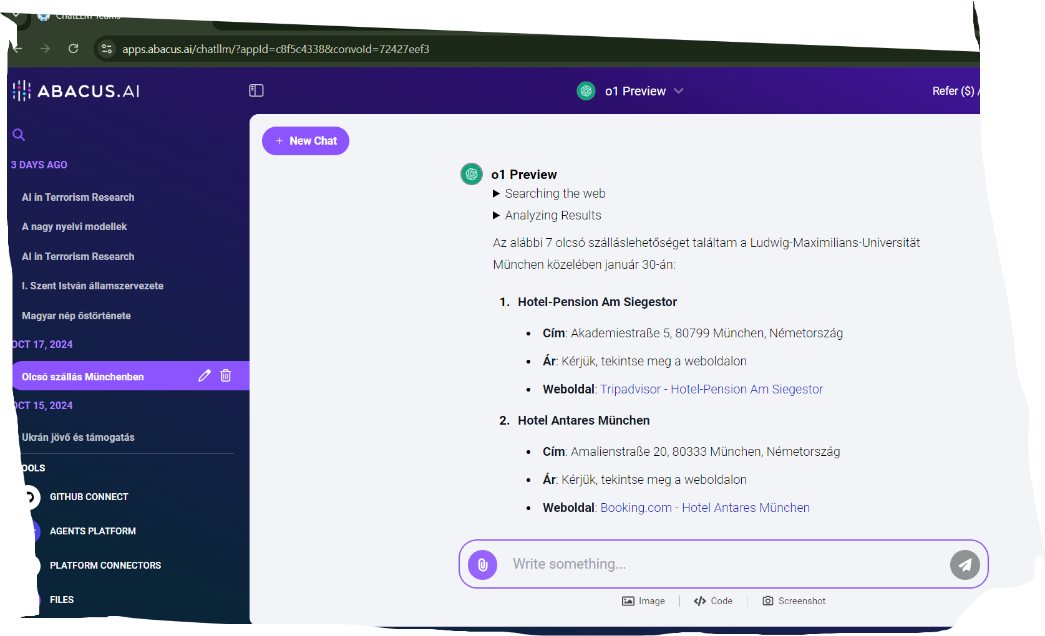
IX. Abacus AI

Slide 101
Abucus AI

Slide 102
X. Google AI Studio – kísérleti labor

Slide 103
XI. Google NotebokLM

Slide 105
XII. Goggle segédprogramok: többirányú szövegelemzés

Slide 106
COSTARL Method
1. Context
2. Objective
3. Style
4. Tone
5. Audience
6. Response
7. Length

Slide 107
Examples in English
Context: Financial Advisor
Objective: Blog Post on Cryptocurrency
Style: Friendly
Tone: Positive
Audience: Novice Investors

Slide 108
Top Ten Academic Prompts
1. Outline Writing
2. Title Generation
3. Peer Review
4. Summary Creation
5. Abstract Writing
6. Meeting Summary
7. Professional Email
8. Explanation
9. Conclusion
10. Keywords

Slide 109
TLDR and TLTR Summaries
TLDR: Too Long; Didn't Read
TLTR: Too Long to Read
Summarize complex information into concise formats.

Slide 110
Academic Prompt Generation
Use academic style,
complex sentences,
structured paragraphs, and
ensure clarity and precision in prompts.

Slide 111
Ludovika University of Public Service on the use of artificial intelligence

Slide 112
22/2024 NKE Rector's Instruction (Ru.) on the use of artificial intelligence
the content part (1) of the AI must be indicated,
the AI application (2) and
functions used with it (3).

Slide 113
Building an AI Culture at the University
Under the leadership of Dr. Gábor Kemény, Vice Rector for Development, and Dr. Balázs Klotz, Head of the Institute for Administrative Continuing Education, a comprehensive AI culture is being developed at the university.
The program aims to make the theoretical and practical applications of artificial intelligence accessible to students and professionals.
AI is taught at existing bachelor's, master's, and PhD levels, as well as through various courses.
The educational programs aim to provide participants with in-depth knowledge in the field of artificial intelligence and enable them to apply it effectively across different multidisciplines.

Slide 114
What might the future bring?

Slide 115
In 5 Years
Personalised Learning: AI-based adaptive systems tailor learning experiences to individual needs, styles, and paces.
Automated Assessment: AI provides quick, objective evaluations and feedback.
Virtual Teachers: Chatbots and virtual tutors assist students in understanding material.
Efficient Data Analysis: AI tools enable rapid, accurate analysis of large data sets.

Slide 116
In 10 Years
Immersive Learning: AI with VR/AR creates interactive, realistic environments.
Predictive Analytics: AI forecasts student performance and identifies challenges.
Overcoming Barriers: Real-time translation and cultural adaptation facilitate global learning.
Acceleration of Discoveries: AI predicts molecular structures and properties.

Slide 117
In 15 Years
Integrated AI Curriculum: AI generates personalised learning materials.
Emotion Recognition: AI adjusts teaching methods based on emotional states.
Lifelong Learning: AI supports continuous learning throughout careers.
Autonomous Research: AI independently generates hypotheses and evaluates results.

Slide 118
In 20 Years
AI-Based Education Standard: AI integration transforms traditional models.
Thought-Controlled Interfaces: Neurotechnology enables direct computer communication.
Global Equality: AI solutions distribute educational resources equitably.
AGI Application: Artificial General Intelligence revolutionises problem-solving.

Slide 119
Summary

Slide 120
CONCLUSION
AI can do everything in research, but it can't do anything perfectly.
AI does not take anyone's job, it takes the job of the person who can use artificial intelligence.
The knowledge and expertise of the researcher remains indispensable - for now.
"If I look at my own work: yes, you read a million and a half documents and write a page of it, which for me would be a week. But the main question is still what goes on inside me during that one week while I'm doing research."
Árpád Rab
NKE Research Institute for Information Society
senior researcher

Slide 121
What can artificial intelligence be used for in research?
1. Answer questions where the answers are based on material that is openly available on the internet.
2. Understanding complex material and ideas.
3. Plan and structure ideas for written work or presentations.
4. Exploring different writing styles and approaches, especially academic ones, for different audiences.
5. Review, evaluate and critically analyse written material.
6. Identify problems with scientific writing, grammar or structure that you can then address.
7. Summaries of notes taken during writings or lectures.
8. Monotonous tasks (editing references, bibliography, etc.)
9. Ever-expanding possibilities (content generation, link searching, text analysis, etc.)
10. And this is just the beginning...

Slide 122
What are the limits?
Data is not always up to date, so you may be relying on sources that are years out of date;
Poor at finding legislation and legal texts;
If the dataset is biased, this bias will be passed on to the generated content;
Totally flawed data - hallucination 3-5% ↔ 10-15% for staff;

Slide 123
Thank you for your attention!

