Slide 1
Artificial Intelligence: Challenges in Public Service Training
DISPA Meeting Budapest
Presentation of best practices concentrating on the daily use of AI within the DISPA Schools
APPLICATION OF AI IN THE PLANNING AND IMPLEMENTATION OF TRAINING COURSES
Sabrina Bandera
24 October 2024

Slide 2



SNA & AI
AI for Training
Training for AI

Slide 3
SNA-AI Strategy
Long-term interventions
Using AI to match training needs and SNA Courses
SNA Data System
Using AI in the internal and administrative processes
Medium-term interventions
AI4SNA - Workshops for SNA Trainers and Staff
AI4SNA - Experimentation
AI Training Guidelines
Courses for Italian Civil Servants
Short-term interventions
3

Slide 4
AI for Training
SNA Research Questions
What are the impacts of AI in terms of training objectives, methodologies, learning?
How can we use AI in civil service training?
How can we use AI to improve training tools and teaching/learning capabilities?

Slide 5

AI and Training Cycle
AI for Training
Training need analysis
Planning
Analytics
Support course participants
Assessment and evaluation
Monitoring
5

Slide 6
AI4SNA - Workshops for SNA Trainers and Staff
06
How, when and where to use AI in SNA training?
Phase 1 – Introduction meetings (November-December 2023)
The use of AI in training
AI methodologies and the role of data
AI experimentation protocol in SNA Courses
Phase 2 - Experimentation (January-September 2024)
Experimentation of AI methodologies and tools in SNA Courses
Phase 3 - Follow up (October-December 2024)
Identification of application scenarios
Definition of Guidelines
6

Slide 7

AI4SNA - Experimentation
06
15
SNA
Courses
Trainers
Teaching Staff
Starting
Meeting
AI
Activities
Testing
Debriefing
7

Slide 8
SNA Course Phases and AI
Course Programme
Teaching Materials
Test
Assessment
Design of
Training Activities
Online Course Catalogue
Selection of Participants
Customer Satisfaction Test
01
02
03
04
05
06
07

Slide 9
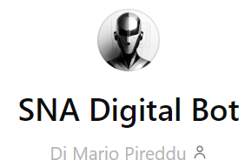
SNA AI Tools
Elevenlabs
Gemini
DaLL – E
Mermaid
Copilot
Speechki
Assistente AI per formatori della Scuola Nazionale dell'Amministrazione
ChatGpt
Synthesia 2.0

Slide 10
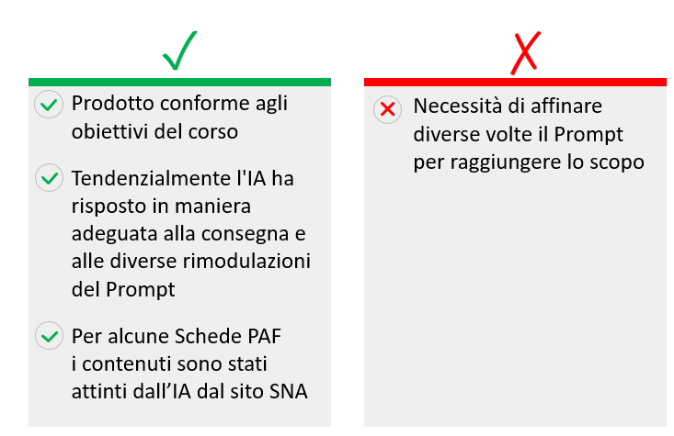
1. Online Course Catalogue
06
Production of the Course presentation schede for the SNA Course Catalogue
SNA Digital Bot
ChatGpt
Gemini
AI Tools
10

Slide 11
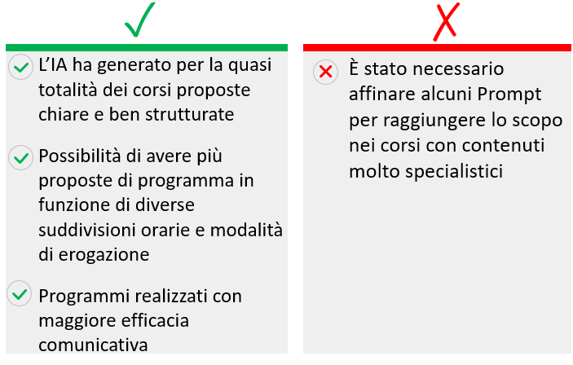
2. Course Programme
06
Realisation of the detailed Course Programme
SNA Digital Bot
Chat Gpt
Gemini
Copilot
AI Tools
11

Slide 12
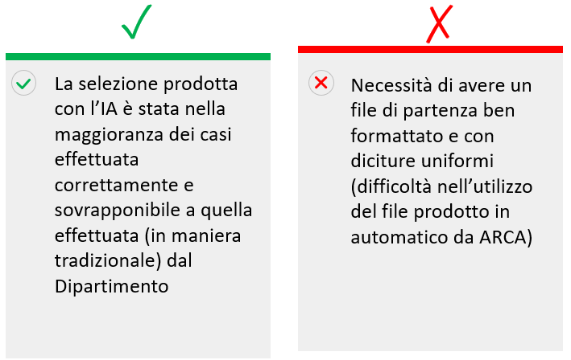
3. Selection of Participants
06
Selection of course applicants according to specified criteria
SNA Digital Bot
AI Tools
12

Slide 13
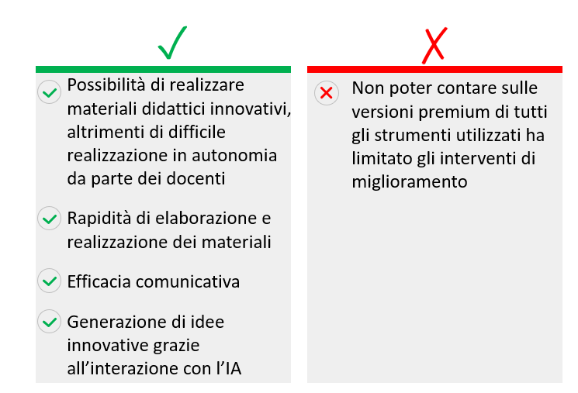
4. Teaching Materials
06
Podcast
ChatGpt
Speechki
Elevenlabs
Presentations
ChatGpt
Mermaid
SNA Digital Bot
Learning Materials
ChatGpt
Video trailer
Synthesia 2.0
13

Slide 14
4. Teaching Materials - Podcast Focus
06
Course Programme
Trainer ad hoc texts
Text realised with AI
Paper (in Italian or in English
Trainer power point presentation
AI Tools
Speechki
Elevenlabs
14

Slide 15


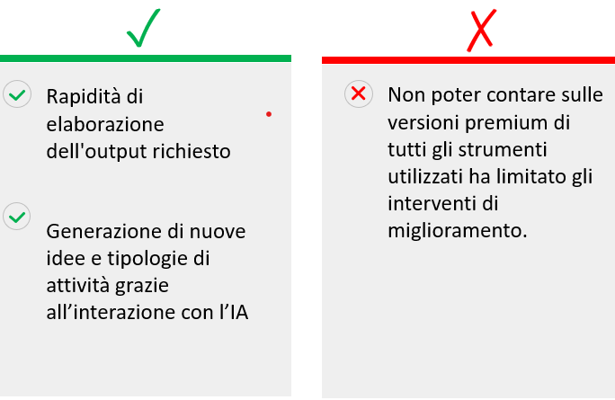
5. Design of Training Activities
06
Pools
ChatGpt
Group Working
ChatGpt
Class Work
ChatGpt
Mermaid
SNA Digital Bot
Gemini
Copilot
15

Slide 16
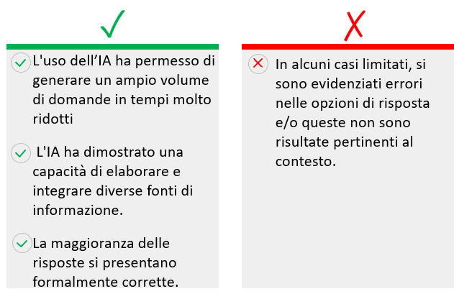
6. Test Assessment
06
Production of the final course Assessment Test from the course materials
SNA Digital Bot
ChatGpt
Gemini
AI Tools
16

Slide 17
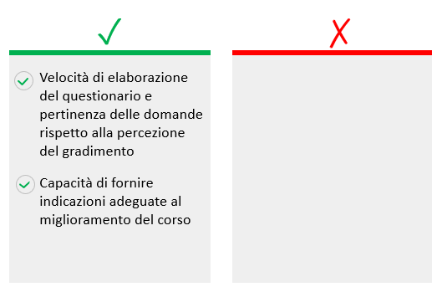
7. Customer Satisfaction Test
06
Production of Customer Satisfaction Test, Survey and Data analyses
SNA Digital Bot
ChatGpt
Copilot
AI Tools
17

Slide 18
Experimentation Synthesis
06
85%
80%
85%
90%
80%
85%
85%
Online Course Catalogue
Course Programme
Selection Participants
Teaching Materials
Design
Trining
Activities
Test Assessment
Customer Satisfaction Test
18

Slide 19

Next Steps
AI process to be introduced for all SNA Courses in 2025
AI SNA Training Guidelines
Training Course for Trainers and Teaching Staff
SNA Podcast series

Slide 20
Lessons Learned
06
Processes
Tools
Skills
20

Slide 21
AI Competency Framework for National Schools of Government
15
 | Level
 | Understand | Apply | Create
Mindset on Al | Understanding benefits & risks | Contextual strategies | Steering long-term impact
Ethics of Al | Human agency | Human-centred use | Al society skills
Al knowledge | Algorithm and data literacy | Use Al analytics | Coding and data models
Application skills | Test and use | lnfusing uses | lntegrating Al tools
Al pedagogy | Al tor teaching | Al to deepen learning | Al for co-creation
Professional support | Al to assist administrative tasks | Al for curriculum design and delivery | Al empowering trainers
ASPECTS
Source: SNA elaboration on UNESCO 2023
21

Slide 22

AI & Public Administration in Italy
Italian Principles using AI in the Public Administration (March 2024)
Improvement of Services and Reduction of Costs
Training and Skills Development
Risk Analysis
Standardization
Transparency, Responsibility and Information
Sustainability
Inclusivity and Accessibility
Foundation Models
Privacy and Security
Data
22

Slide 23
AI & Public Administration in Italy
The Italian Stretegy for AI 2024-2026
(July 2024)

Slide 24
AI & Public Administration in Italy
The Italian Stretegy for AI 2024-2026
(July 2024)
PA 6. AI in the Schools for the Public Administraion
Provides for a specific action plan for the upskilling of civil servants (SNA & Local Schools)
A specific Department dedicated to AI will be set up within the SNA providing for the organisation of post-graduate training courses for public servants
Developing innovation capability in PA in collaboration with Universities and Research Centers

Slide 25
AI & Public Administration in Italy
AI Italian Law
(under discussion in the Parliament)
Art. 13 – The use of AI in Public Administration
Goals:
Increasing efficiency
Time reduction for defining procedures
Improving the quality and quantity of services provided
Guiding principles:
The use of AI in Public Administration schould guarantee
Transparency and accessibility in terms of knowledge (conoscibilità)
Traseability (tracciabilità)
Adequate tools for applying AI (funzione strumentale)
The Public Administrations adopt technical, organizational
and training measures, aimed at ensuring a "responsible" use of AI
and developing the transversal capabilities of users.

Slide 26





Founded in 1957, the Scuola Nazionale dell’Amministrazione (SNA) - the Italian National School of Government, is part of the Cabinet Office structure and is tasked with recruiting and training middle and senior management for the Italian civil service, promoting innovation and reform and fostering research.
Sabrina Bandera
Head of Research Innovation and Strategy Division
s.bandera@governo.it
http://linkedin.com/in/sabrinabandera
www.sna.gov.it
SNA-Scuola Nazionale dell'Amministrazione
ricerca.sna@governo.it

